Slide 1
Modular Flux Transfer Efficient Rendering of High-Resolution Volumes with Repeated Structures
Shuang Zhao*
Miloš Hašan†
Ravi Ramamoorthi§
Kavita Bala*
*Cornell University
†Autodesk Inc.
§University of California, Berkeley
Notes:
Hello everyone!
Today I will talk about a new method to speed up the rendering of high-resolution volumes with repeated structures.

Slide 2
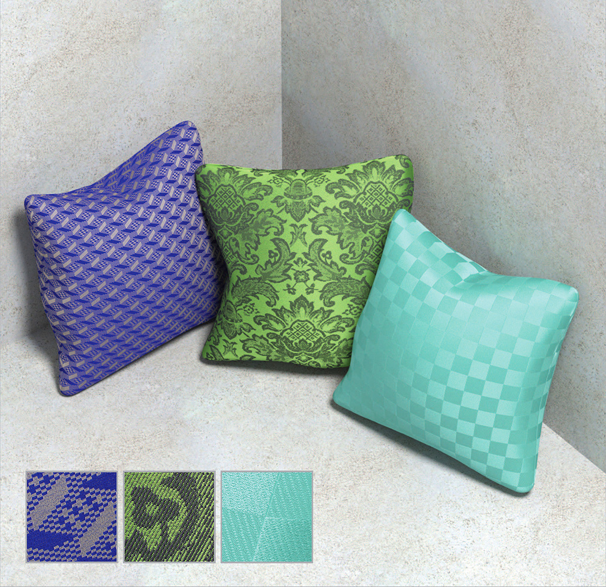
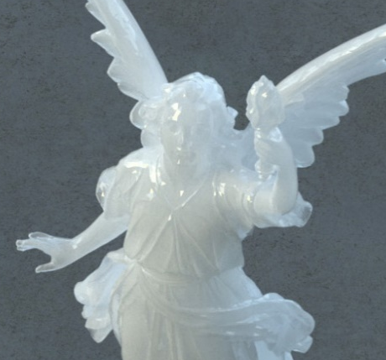
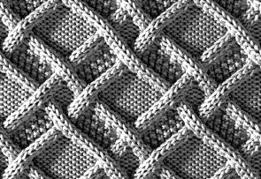
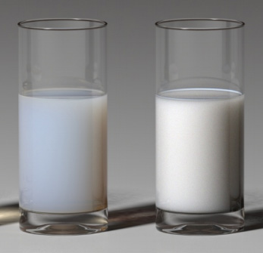
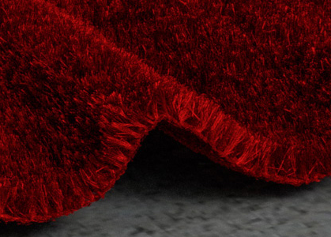
Volumetric Appearance Models
[Gkioulekas et al. 2013]
[Yuksel et al. 2012]
[Zhao et al. 2012]
[Frisvad et al. 2007]
[Zhao et al. 2011]
Notes:
Volumetric appearance models are capable of generating images with great fidelity, especially for materials with [click] strong subsurface scattering or [click] complex mesostructure.
But rendering them is not easy.

Slide 3
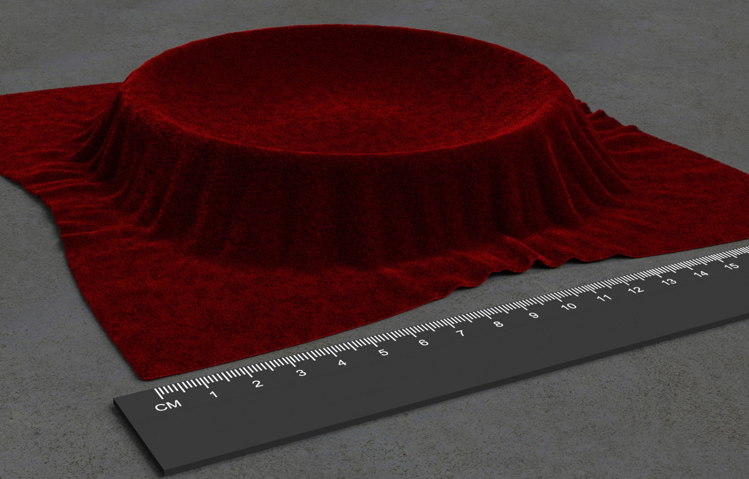
Challenge
Velvet
Highly scattering
… … …
Highly detailed
Tons of voxels
[Zhao et al. 2011]
Notes:
In particular, the volume models offering highest-quality renderings are often with micron-level details, [click] causing the entire volume to contains tons of voxels.
Such complexity makes light transport simulation extremely expensive.
[Click] Among those volumes, ones with very little absorption are most challenging, since light can travel within them for a long time.

Slide 4
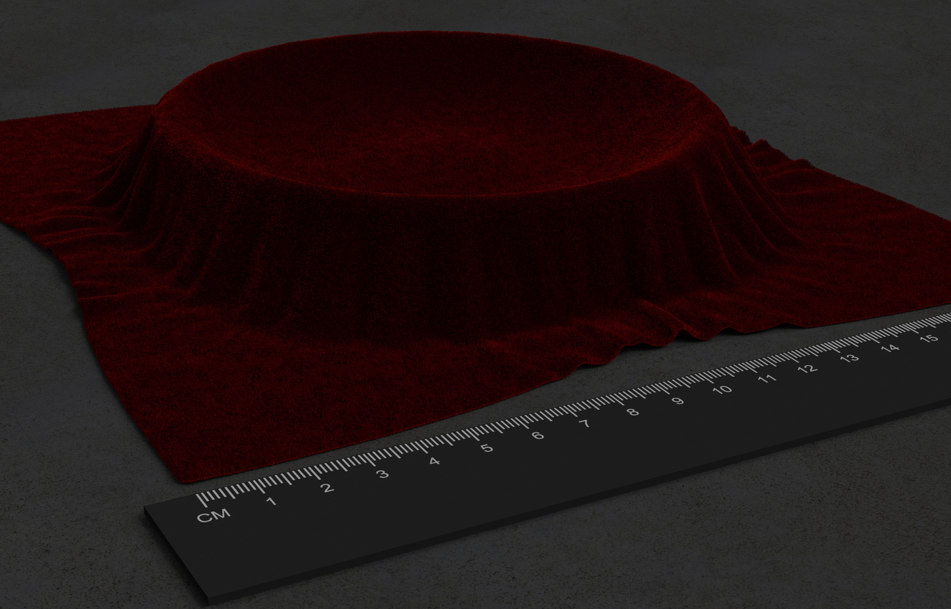
Challenge
for tens to hundreds of core hours
Please wait.
Rendering…
Notes:
As a result, the rendering of such high-resolution and highly scattering volumes is very slow, normally taking tens to hundreds of core hours.

Slide 5
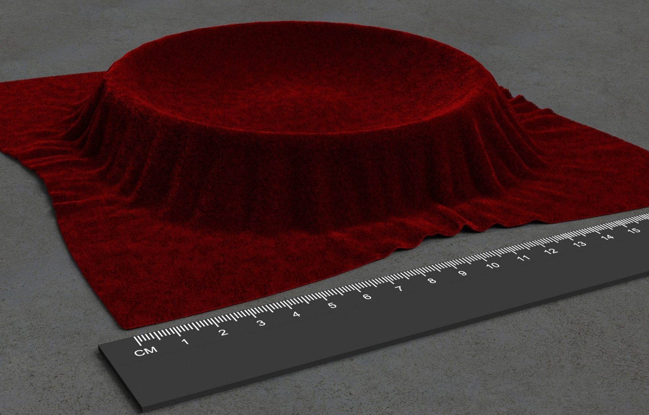
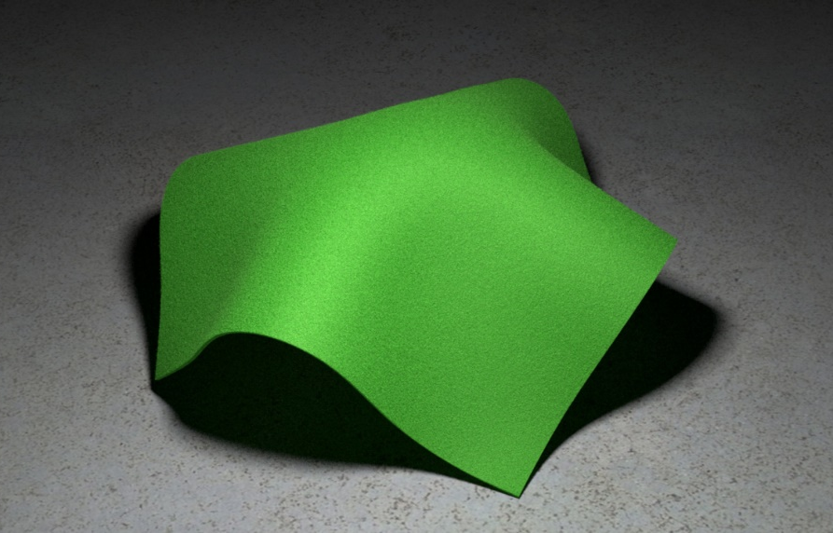
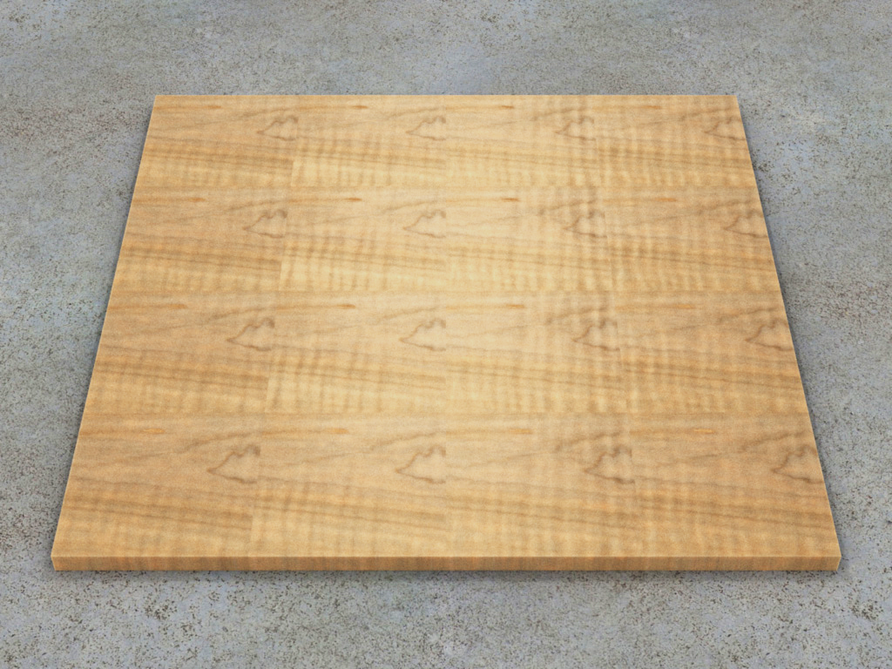
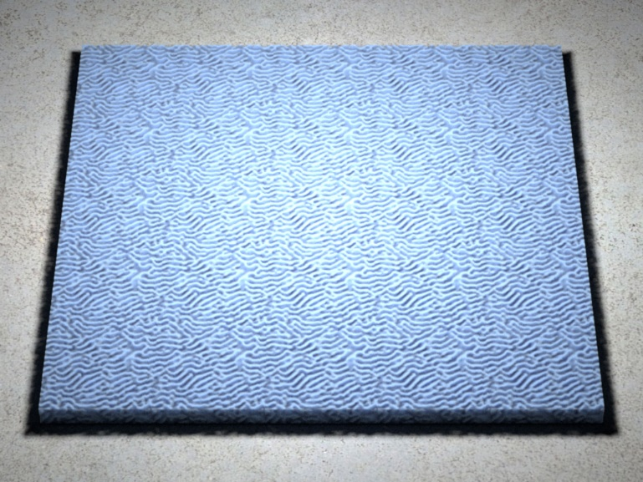
Our Goal
Efficient rendering of high-resolution, highly scattering volumes
Renders 10X faster
Focus on cloth
Generalize to others
Notes:
So our goal is to develop a technique that renders such volumes up to an order of magnitude faster than standard Monte Carlo methods.
Our method [click] focuses on cloth but [click] generalizes to other materials such as wood.
(Preview: Next, we give some background on rendering and creating volume models.)

Slide 6
Background
Notes:
Next, we give some background on rendering and creating volume models.

Slide 7
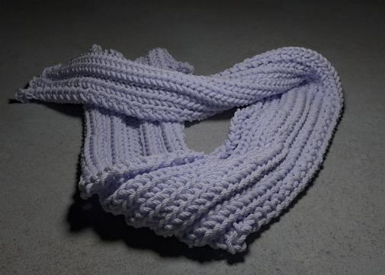
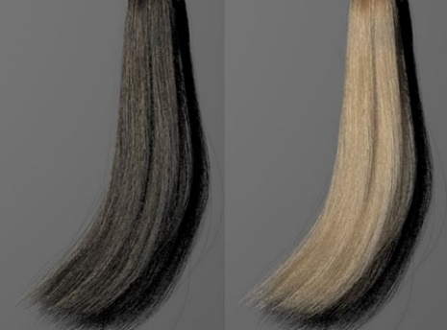
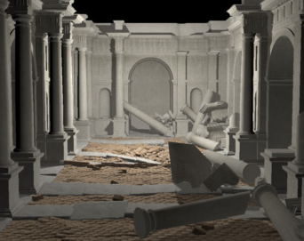
Related Work
Radiative transfer
[Ishimaru 1978], [Jakob et al. 2010], …
Approximation solutions
Diffusion approximation [Jensen et al. 2001], [Wang et al. 2008], [Arbree et al. 2011], …
Approximating high-order scatterings [Moon and Marschner 2006], [Jarosz et al. 2011], …
Precomputation-based methods
[Xu et al. 2001], [Loos et al. 2011], …
[Jakob et al. 2010]
[Moon and Marschner 2006]
[Loos et al. 2011]
Notes:
There is a large body of work related to this paper.
Radiative transfer provides a mathematical foundation for modeling volumetric light transport.
To simulate it efficiently, [click] a great amount of research has been done.
[Click] Among those, there are methods based on precomputation.
We took significant inspiration from the work done by Loos et al., as we will later see.
Please see the paper for a more comprehensive discussion on related work.

Slide 8
Path Formulation
Pixel value
=
weighted sum
of
path contributions
[Veach 1997; Pauly et al. 2000]
Notes:
To render the volume models, we need to simulate light transport in the scene.
In this talk, we use a path formulation where the intensity of each pixel equals an integral, or a weighted sum, over contributions from paths connecting that pixel and the light source.
An example light path is shown at the bottom.

Slide 9
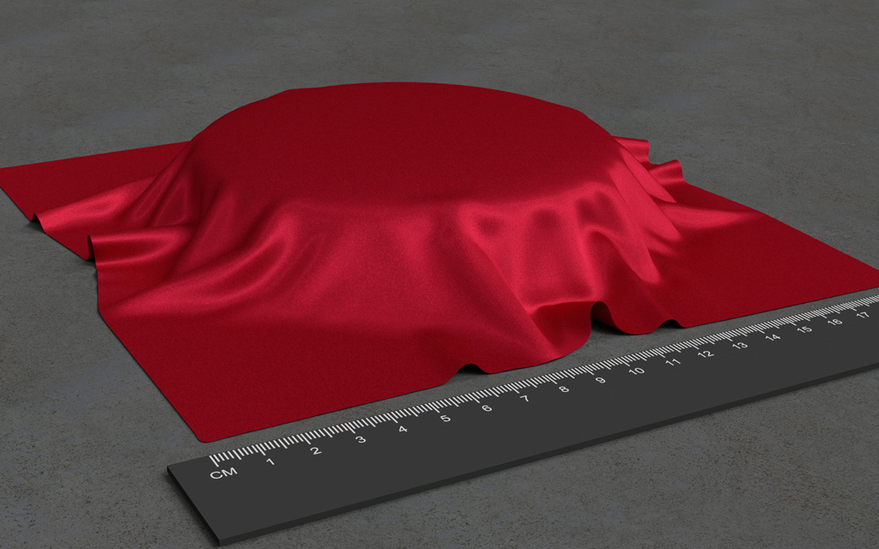
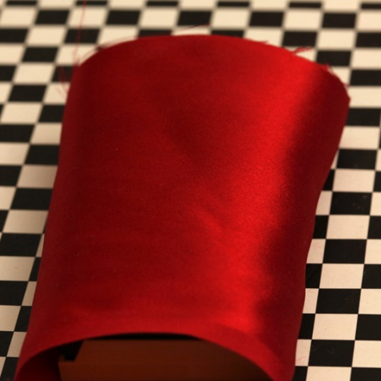
Volumetric Model Creation
+
Micro CT scan (structure)
Photograph (appearance)
Volumetric appearance models
[Zhao et al. 2011]
Notes:
We have seen how to render a scene.
But how are the models in the scene created in the first place?
In 2011, we developed a method that combines computed tomography scans with a photograph, to create volumetric fabric models with micron-level details.

Slide 10
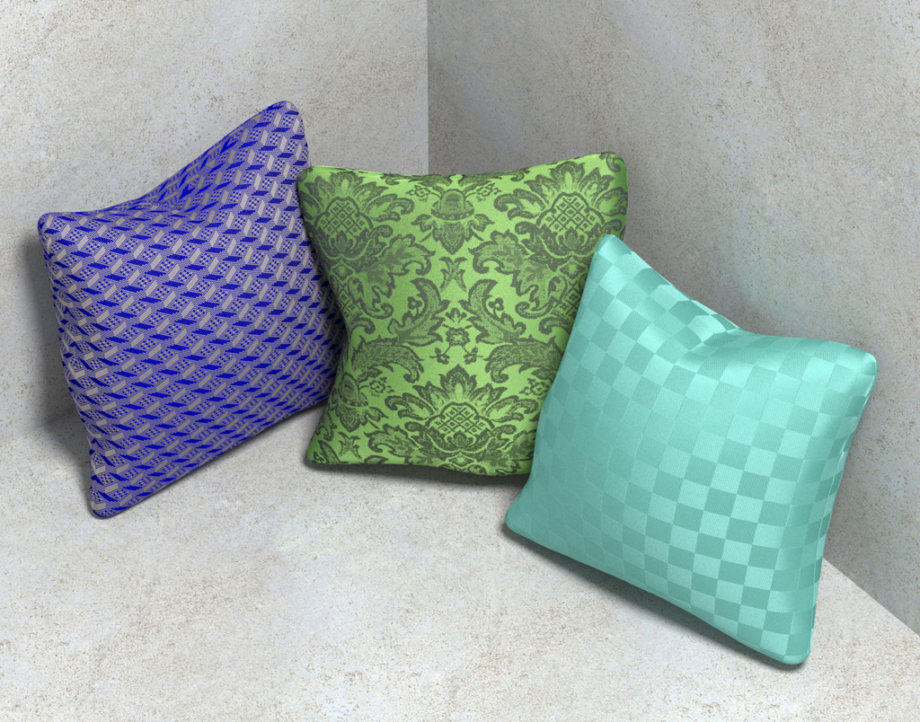
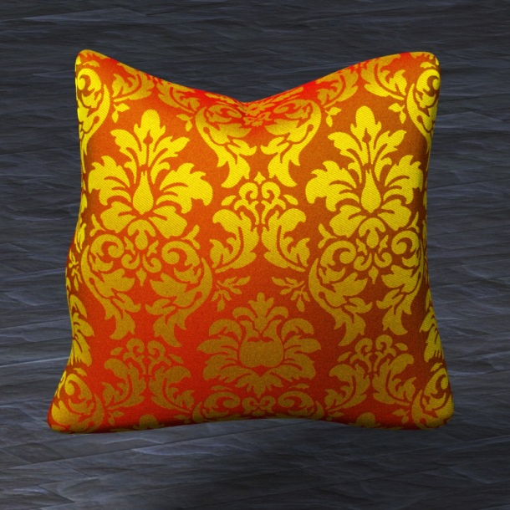
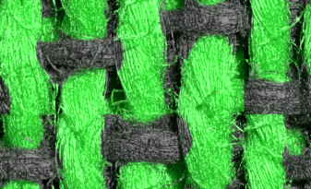
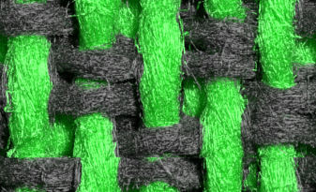
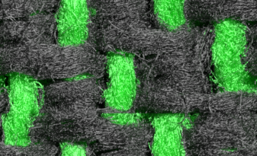
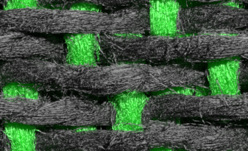
Volumetric Model Creation
[Zhao et al. 2012]
Notes:
Last year, we generalized this technique to build models with complex designs.

Slide 11
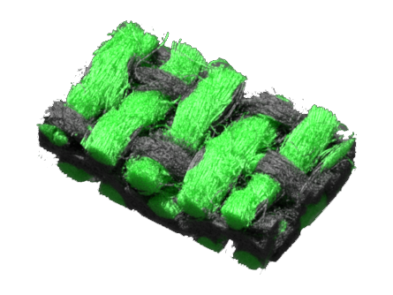
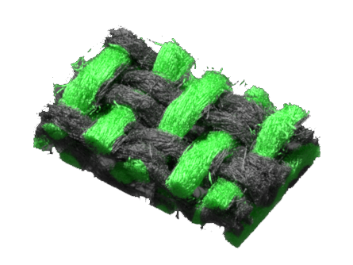
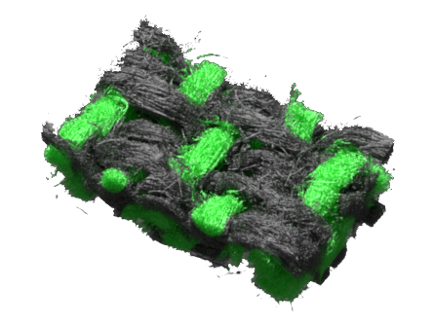
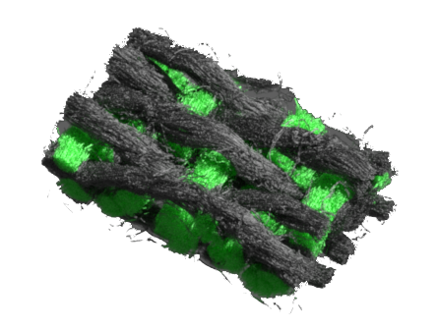
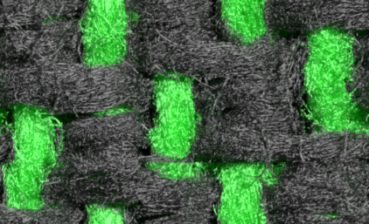
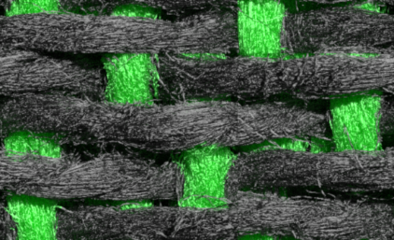
Volumetric Model Creation
Exemplar Blocks
Volumetric Fabric Models
(top view)
[Zhao et al. 2012]
Notes:
We first create several volumes with elementary weave patterns.
[Click] We’ll show them in top view for clearer visualization.
[Click] Then, the volumes are chopped equally into a set of pieces, called exemplar blocks.

Slide 12
Volumetric Model Creation
Exemplar Blocks
Final Volume
[Zhao et al. 2012]
Notes:
Using those as basic building blocks, volumes with different designs can be built.
(Wait for the animation to complete)
(Preview: Although the number of exemplar blocks is relatively small)

Slide 13
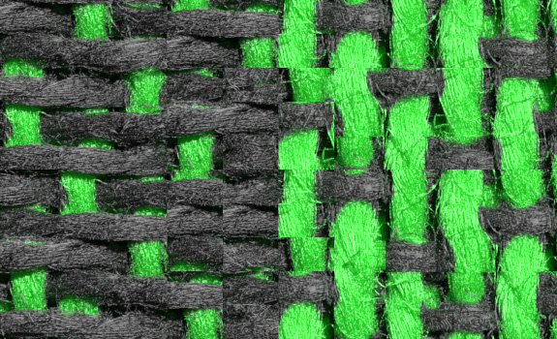
Volumetric Model Creation
Exemplar Blocks
Final Volume
100 Blocks
1 000 000 Blocks
[Zhao et al. 2012]
Notes:
Although the number of exemplar blocks is relatively small, the final volume can contain millions of blocks.
Because of this model creation process, knowing light transfer properties of the exemplar blocks can greatly help solving that of the final volume.

Slide 14
Idea: Modular Transfer
Exemplar Blocks
Exemplar Blocks
Final Volume
… … … …
Precompute light transport
Modularly combine on-the-fly
Inspired by [Loos et al. 2011]
Notes:
So in this paper, we want to precompute light transfers for each exemplar block, and [click] combine such information on-the-fly to speed up the rendering process.
[Click] We took the inspiration from Loos et al. who introduced a similar idea for surface-based rendering of blocked scenes.
We instead focus on complex volumes with millions of blocks.

Slide 15
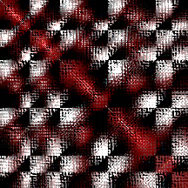
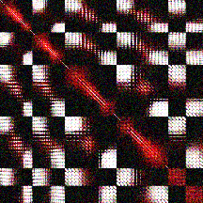
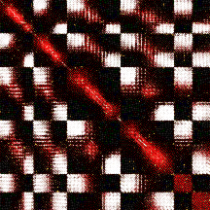
Our Contribution
[
]
-1
…
billions
billions
A new formulation for rendering high-resolution volumes by exploiting modularity
A Monte Carlo Matrix Inversion (MCMI) based algorithm scalable to billions of blocks
Notes:
Our contribution includes a new formulation for rendering high-resolution volumes by exploiting modularity.
[Click] And we provide a Monte Carlo Matrix Inversion based algorithm to make our approach scalable to very large volumes with billions of voxels.

Slide 16
Idea: Modular Transfer
Exemplar Blocks
Final Volume
… … … …
Precompute light transport
Modularly combine on-the-fly
Notes:
Recall that we would like to precompute light transport for each exemplar block.
But how should we implement this?

Slide 17
Curse of Dimensionality
(8 dimensional)
Exemplar block
Exemplar block
Exemplar block
Incoming light field
Incoming light field
Outgoing light field
Expensive to represent!
(4 dimensional)
(4 dimensional)
(4 dimensional)
Notes:
Given an exemplar block, the incoming light field captures the [click] radiance at each surface location pointing at all inward directions.
[Click] It is 4D as there are two dimensions for location, and another two for direction.
[Click] The outgoing light field can be defined similarly.
[Click] Ideally, we want to compute the linear operator T, [click] an 8D quantity, that converts incoming light fields to outgoing ones.
Unfortunately, [click] representing T in a tractable way while providing high-quality rendering is difficult.
To overcome this curse of dimensionality, we introduce approximations that remove directional dependencies.

Slide 18
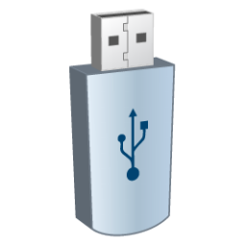
Approximations
(8 dimensional)
(4 dimensional)
Exemplar block
Exemplar block
Incoming light field
Much less data
Outgoing light field
(4 dimensional)
(2 dimensional)
(2 dimensional)
(4 dimensional)
Notes:
For example, we could attach a diffuser to each face of the block, [click] then the direction along which the light enters or leaves will no longer matter.
[Click] And we can store the incoming and outgoing light fields in 2D, [click] making the problem tractable.
Such approximations, however, need to be applied in the right way.

Slide 19
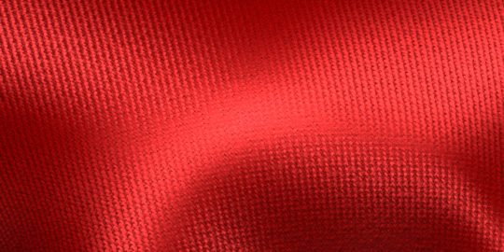
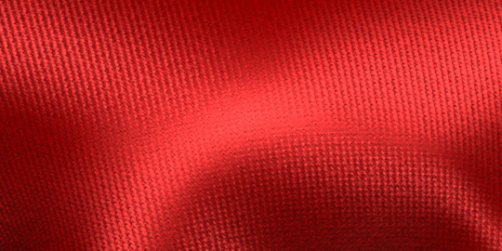
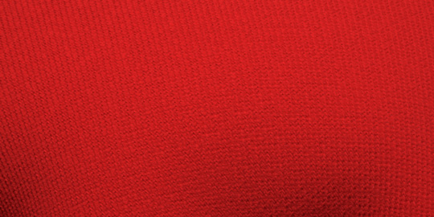
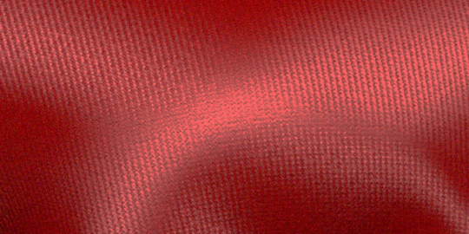
Good vs. Bad Approximations
Ground truth
Our approach
(for long paths only)
Bad approximation
Our approach (for all paths)
Notes:
If too much directional dependencies are ignored, view-dependent effects, such as specular highlights, can be completely missing.
[Click] When applying our approximation scheme, which I will present later, in a naïve way, we can get an okay match.
But the result is not as shiny as the ground truth.
Since the high-frequency effects are mostly caused by low-order scattering, [click] we can approximate only long paths, resulting in high-quality results.

Slide 20
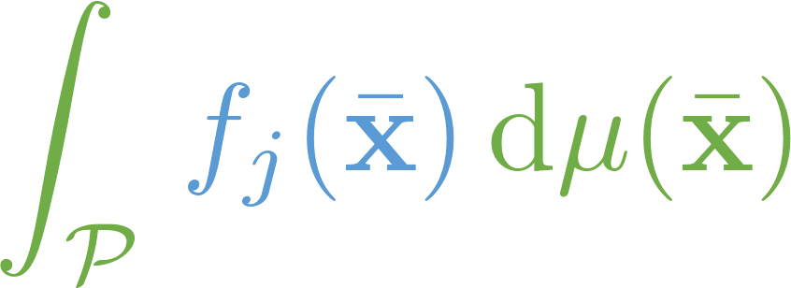
Our Solution
Short light paths
Long light paths
Light paths
Weighted sum
of path contributions
(Easy to compute)
(Expensive to simulate)
Compute approximately by splitting into precomputed and run-time components
Compute exactly (brute-force)
Notes:
So here is a summary of our solution.
First, we put light paths [click] into two categories according to their lengths.
[Click] We use standard techniques to compute short paths.
[Click] For longer ones which often consume most of the rendering time, we compute approximately by splitting the task into precomputed and run-time components.

Slide 21
Definitions and
Pipeline Overview
Notes:
Before diving into the details, I will first give some useful definitions and an overview of our pipeline.

Slide 22
Definitions
Exemplar Blocks
One Block
Final Volume
Notes:
Assume that we have a volume [click] containing equal-sized blocks, [click] each of which comes from a set of exemplar ones.

Slide 23
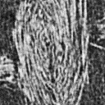
Definitions
Voxels
Interfaces
Patches: P₁, P₂, P₃
P₃
Block 1
Block 2
P₂
Block 3
Thousands of cloth voxels
P₁
One voxel
Scale hierarchy
Cloth voxels
Final Volume
Voxel
Block
Notes:
Here we show a volume with just 3 blocks.
[Click] Then we chop each block into a number of voxels.
Here voxels are defined independent of the underlying representation of the volume.
[Click] For example, when handling the cloth volumes, each voxel under this definition can contain thousands of micron-sized cloth voxels.
[Click] The surfaces shared by two blocks are called interfaces.
[Click] We also define patches as oriented voxel faces on an interface.

Slide 24
Definitions
3 types of light transfer
Voxel-to-voxel transfer
Patch-to-patch transfer
Patch-to-voxel transfer
Notes:
Based on these definitions, we define three types of transfers: [click] voxel-to-voxel, [click] patch-to-patch, and [click] patch-to-voxel.

Slide 25
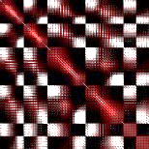
Precomputation: Overview
Precompute
3 types of light transfer
for each exemplar block
Precomp.
Can be reused for different designs:
…
Voxel-to-voxel transfer
Patch-to-patch transfer
Patch-to-voxel transfer
Precomp.
Pipeline:
Notes:
Because the final volume is built from a small set of exemplar blocks, we can precompute these transfers for each of them.
[Click] This makes the first component of our pipeline.
[Click] And the precomputed information can be reused on other synthesized volumes.

Slide 26
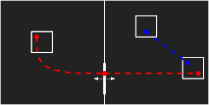
Run-Time Evaluation: Overview
Source flux evaluation
Run-time evaluation
Modular flux transfer
Final gathering
Precomp.
Run-time evaluation
Pipeline:
Notes:
The other component is run-time evaluation.
It has three parts.
[Click] First, we evaluate the incoming light, or the source flux, at each voxel.
[Click] Then, we propagate such energy using the precomputed information through a modular flux transfer framework.
[Click] Finally, we perform final gathering to speed up the rendering.

Slide 27
Precomputation
Definitions and
Pipeline Overview
Precomp.
Run-time evaluation
Transfer Matrix Computation
Source Flux Evaluation
Modular Transfer
Final Gathering
Precomp.
Run-time evaluation
Pipeline:
Notes:
We have seen the overview of our pipeline.
[Click]
Next, I will go through the individual steps, [click] starting with the precomputation stage.

Slide 28
Precomputation
Total number of voxels
An $n×n$ symmetric matrix
Precompute 3 types of light transfer for each exemplar block
Voxel-to-voxel
Voxel-to-voxel
Patch-to-patch
Patch-to-voxel
Notes:
Let us take a closer look at the light transfers we need to precompute for each exemplar block.
[Click] For the voxel-to-voxel transfer, let n be the total number of voxels in the block.
We need to compute an n-by-n matrix.

Slide 29
Precomputation
Total number of voxels
An $n×n$ symmetric matrix
Voxel-to-voxel
Definition of
Virtual light
Light meter
Notes:
Intuitively, the (i, j)-entry of this matrix captures the amount of energy, or flux, [click] a virtual light meter in voxel j receives when [click] putting in voxel i a virtual light source with unit intensity.
[Click] Precisely, this value equals the integral over all paths connecting voxel i and j.

Slide 30
Precomputation
Total number of voxels
An $n×n$ symmetric matrix
Voxel-to-voxel
Compute using a particle tracing based algorithm
……
Notes:
In practice, we compute the matrix using a particle tracing based algorithm, [click] one column at a time.
More details are in the paper.

Slide 31
Precomputation
Total number of voxels
An $n×n$ symmetric matrix
Voxel-to-voxel
Total number of patches
An $m×m$ symmetric matrix
Patch-to-patch
An $n×m$ asymmetric matrix
Patch-to-voxel
Notes:
The other two types of transfer matrices are defined in similar ways.
In the end, we get two symmetric transfer matrices.
The patch-to-voxel transfer matrix is rectangular and equals the transpose of the voxel-to-patch one.

Slide 32
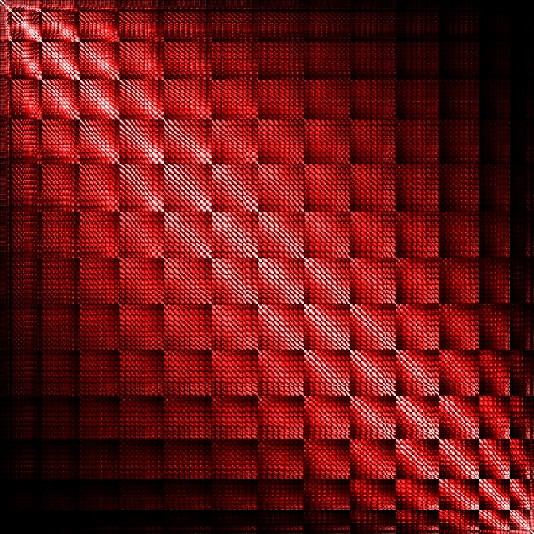
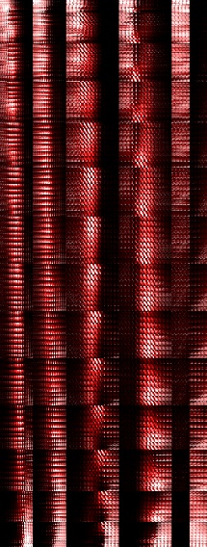
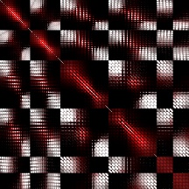
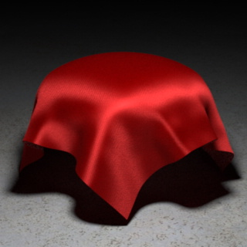
Precomputation
Patch-to-patch transfer
Voxel-to-voxel transfer
Patch-to-voxel transfer
Notes:
Here we show the transfer matrices of an exemplar block from a shiny twill material shown on the bottom-right corner.
We can see that the voxel-to-voxel and patch-to-patch transfer matrices are both symmetric.
And the former is larger because there are more voxels than patches.

Slide 33
Run-Time Evaluation
Definitions and
Pipeline Overview
Precomp.
Run-time evaluation
Transfer Matrix Computation
Source Flux Evaluation
Modular Transfer
Final Gathering
Notes:
Next, let us take a closer look at the [click] run-time component.
Due to the time constraint, I will only show the high-level ideas while omitting most of the mathematical details.

Slide 34
Multiple-Scattered Flux ( )
Speed up!
Notes:
The main goal of the run-time component is to evaluate multiple-scattered flux at all voxels.
[Click] When performing path tracing, we can use them to [click] approximate indirect illumination in a voxel, [click] so that we can terminate the path early and obtain [click] significant speed up.

Slide 35
Source Flux ( ) Evaluation
Single-scattered flux
Notes:
To obtain the multiple-scattered flux, [click] we first convert the physical light source into a set of virtual ones inside the voxels, [click] which captures flux from single-scattered light.
[Click] The vector representing the intensities of those virtual lights is called the source flux vector.

Slide 36
Source Flux ( ) Evaluation
Uniform emission
scattering event
scattering event
Isotropic Event
Notes:
Note that our virtual lights emit radiance uniformly in all directions.
[Click] This means that we effectively altered the phase function at one scattering event to isotropic.
[Click] And we call this approximation an isotropic event.

Slide 37
Source Flux ( ) Evaluation
is sparse
Noise will be averaged out
Notes:
To compute the source flux vector, we trace a number of particles from the physical light source, and deposit energy at the first scattering events.
Then for each voxel, [click] we sum up all energy it contains, [click] and create a virtual light source accordingly.
[Click] The benefit of evaluating source flux this way is that we can control the sparsity of the source flux vector, since the number non-zero components is bounded by that of traced particles.
[Click] And the noise created in this process will later be averaged out by applications of transfer matrices.

Slide 38
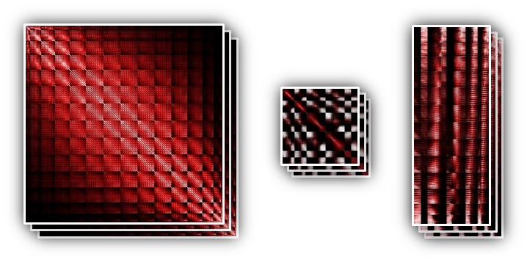
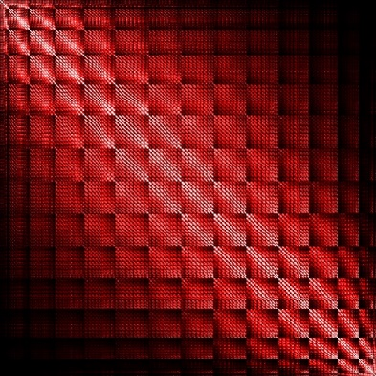
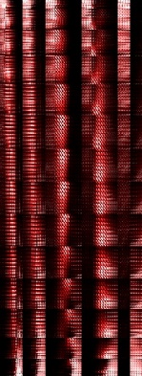
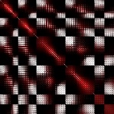
Modular Flux Transfer
Source Flux
Multiple-Scattered Flux
using
Notes:
Next, we present the modular flux transfer framework.
It turns the source flux [click] into multiple-scattered one, [click] using the precomputed transfer matrices.

Slide 39
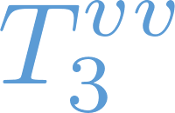
Modular Flux Transfer
Block 1
Block 2
Block 3
=
Intra-block transfer
Notes:
Suppose that we would like to know [click] the scattered flux in voxel i.
[Click] First, we apply voxel-to-voxel transfer to get the energy from all the virtual lights in block 3, such as one in voxel j.
[Click] This gives us all energy coming from the same block as voxel i.

Slide 40
Modular Flux Transfer
interface
interface
Diffuser Event
diffuser
Block 1
Block 2
Block 3
=
Intra-block transfer
+
Inter-block transfer
Notes:
Next, we propagate flux across blocks, such as from voxel k to i.
[Click] We start with sending the flux to the block interface by applying the voxel-to-patch transfer, [click] and “flipping” to the other side.
[Click] Then we perform a patch-to-patch transfer and another flipping to get to block 3.
[Click] Finally, we send the energy back to voxel i with the patch-to-voxel transfer.
[Click] Note that we do not keep track of directions along which rays travel across the interfaces.
[Click] This is equivalent to inserting a diffuser at every block interface, [click] and is called a diffuser event.

Slide 41
Modular Flux Transfer
One patch-to-patch transfer
Block 1
Block 2
Block 3
=
Intra-block transfer
+
Inter-block transfer
Notes:
We have seen one way to send energy from voxel k to i using only one patch-to-patch transfer.
But it’s not the only way, since we can include any number of such transfers.

Slide 42
Modular Flux Transfer
Three patch-to-patch transfers
Block 1
Block 2
Block 3
=
Intra-block transfer
+
Inter-block transfer
Notes:
In this example, there are three.

Slide 43
Modular Flux Transfer
Five patch-to-patch transfers
Block 1
Block 2
Block 3
=
Intra-block transfer
+
Inter-block transfer
Notes:
And this one has five.

Slide 44
Modular Flux Transfer
Inter-block transfer
=
Energy propagated with patch-to-patch transfers
Formulated as a Neumann series
Computing a matrix inversion
[
]
-1
billions
billions
Inter-block transfer
Notes:
In general, we need to compute an infinite sum to capture energy propagated with any number of patch-to-patch transfers.
[Click] This can be formulated as a Neumann series, [click] which includes a matrix inversion.
Note that the outcome of this computation is the multiple-scattered flux vector, whose dimensionality equals the total number of voxels, which can be in billions.

Slide 45
Monte Carlo Matrix Inversion
Estimate using a random walk
Block 1
Block 2
Block 3
Based on [Forsythe and Leibler 1950]
Notes:
To avoid excessive storage, we introduce a Monte Carlo Matrix Inversion based algorithm, which provides an unbiased estimate for one component of the vector using a random walk.
[Click] Suppose we want to know the multiple-scattered flux in voxel i.
The random walk then starts from this voxel and tries to get back to some virtual light source.
[Click] First, we sample a patch in the same block according to the patch-to-voxel transfer and [click] do a flipping.
Next comes a loop: in each iteration, (we first roll a dice)

Slide 46
Monte Carlo Matrix Inversion
Estimate using a random walk
Block 1
Block 2
Block 3
Based on [Forsythe and Leibler 1950]
Notes:
we first roll a dice and decide whether to continue.
[Click] If so, we sample another patch [click] using the patch-to-patch transfer and [click] flip to the other side.
[Click] We repeat this process, until at some point [click] the dice roll gives a stop.
Next, we [click] sample a voxel j using the voxel-to-patch transfer.

Slide 47
Monte Carlo Matrix Inversion
Intra-block transfer
Estimate using a random walk
Throughput
Block 1
Block 2
Block 3
Based on [Forsythe and Leibler 1950]
Notes:
[Click] Then the inter-block contribution equals the source flux in voxel j times [click] the throughput v, which is maintained during the entire random walk.
[Click] Finally, we add the intra-block part to obtain the multiple-scatter flux in voxel i.

Slide 48
Average indirect illumination in voxel
Notes:
Now we can estimate the multiple-scattered flux at any given voxel.
[Click] And it can be shown that this value equals the average indirect illumination in that voxel.

Slide 49
Average indirect illumination in voxel
Precomp.
Run-time evaluation
Transfer Matrix Computation
Source Flux Evaluation
Modular Transfer
Final Gathering
Notes:
The last step of the run-time evaluation, [click] final gathering, uses this property to accelerate the rendering process.

Slide 50
Final Gathering
Based on standard volume path tracing
Approximate indirect illumination using
Picked
Notes:
This step is based on standard Monte Carlo path tracing.
Given a number k, [click] we compute first (k – 1) scatterings exactly.
At the k-th scattering event, we [click] compute the direct illumination accurately and [click] approximate the indirect using the multiple-scattered flux.
[Click] In our experiments, we picked k = 6 which offers a good balance between performance and accuracy.
(Preview: Next, I will show some experimental results.)

Slide 51
Experimental Results
Notes:
Next, I will show some experimental results.

Slide 52
1000 voxels 500 patches
Exemplar Block
Thousands of cloth voxels
One voxel
Precomputation time (per block): 4 hours
Notes:
For each exemplar block, we picked a resolution such that [click] it has around 1000 non-empty voxels and 500 patches.
[Click] Remember the voxels here are often much larger than the real cloth ones.
[Click] And precomputing all transfer matrices for a block takes 4 hours.

Slide 53
Total Blocks: 250 000
Exemplar Blocks: 25
Reference (90 mins)
Our Result (10 mins, 9X)
Notes:
Here we show a shiny fabric with 250 thousand blocks created using 25 exemplar ones.
It takes 90 minutes to render using normal path tracing.
[Click] When accelerated with our method, we get a very good match with a 9X speedup.

Slide 54
(single precomputation)
Notes:
When the lighting changes, the single precomputation can be reused to create consistent and high-quality results.

Slide 55
Total Blocks: 250 000
Exemplar Blocks: 25
Reference (192 mins)
Our Result (15 mins, 12.8X)
Notes:
This is a highly scattering velvet with characteristic grazing-angle highlights.
The thickness of this material results in a rendering time of 192 minutes.
[Click] Our method achieves a 12.8X speedup, and the rendering matches the reference image well.

Slide 56
High noise
Significant darkening
Notes:
Here we show two path traced results created in similar time.
[Click] When not limiting the maximal path length, we can only afford a small number of samples per pixel, resulting in high noise.
[Click] If we limit the maximal path length by terminating all paths after 6 scatterings, the result shows significant darkening because the high-order scattering is missing.

Slide 57
Total Blocks: 1 350 000
Exemplar Blocks: 120
Reference (108 mins)
Our Result (15 mins, 7.2X)
Notes:
Now we switch to another set of results synthesized from 120 exemplar blocks.
After a single precomputation, the transfer matrices can be used to accelerate renderings of fabrics with different designs.
This is a reference image of a damask design.
[Click] Our method provides a 7.2X speedup, and our result matches the ground truth very well.

Slide 58
Total Blocks: 1 350 000
(same exemplar blocks)
Reference (108 mins)
Our Result (15 mins, 7.2X)
Notes:
Here we show the rendering of a new design under a different illumination.
[Click] Our result generated based on the same precomputation is visually identical to the reference.

Slide 59
(single precomputation)
Notes:
Here we show an animated cloth.
Again, all frames in this video have been created using a single set of precomputed transfer matrices.

Slide 60
Notes:
When zooming in, we can see the detailed surface structures demonstrating the complexity of this volume.

Slide 61
Model based on [Marschner et al. 2003]
Reference (17 mins)
Our Result (5.6 mins, 3X)
Notes:
Our method also generalizes to non-cloth materials.
This is a piece of finished wood represented with an anisotropic volume.
The complexity of this volume is nowhere close to those we just saw.
[Click] Our approach still provides a speedup of 3X.

Slide 62
Conclusion
We introduced a precomputation based approach
Accelerates renderings of very complex volumes built from sets of exemplar blocks
Exemplars Blocks
Final Volumes
… …
Notes:
To conclude, we introduced a precomputation-based approach [click] to accelerate renderings of very complex volumes built from sets of exemplar blocks.

Slide 63
Conclusion
We introduced a precomputation based approach
Accelerates renderings of very complex volumes built from sets of exemplar blocks
By approximating high-order scattering using a Modular Flux Transfer framework
Precomp.
Run-time Evaluation
Transfer Matrix Computation
Source Flux Evaluation
Modular Transfer
Final Gathering
Notes:
Our algorithm separates low-order and high-order scatterings and approximates the latter using a modular flux transfer framework.

Slide 64
Future Work
Extending this framework to permit material editing using [Hasan and Ramamoorthi 2013]
Reducing the precomputation cost
Better heuristics for choosing adaptively
Notes:
In the future, we plan to extend our framework to allow precomputation with material editing.
One possibility is to combine our method with the one Milos just presented.
[Click] Also, our precomputation stage is based on Monte Carlo particle tracing, and further optimizations will be helpful.
[Click] Finally, the path length beyond which our approximations are applied is now picked as a global constant.
It would be great to have some heuristics to choose its value adaptively.

Slide 65
Thank you!
Modular Flux Transfer Efficient Rendering of High-Resolution Volumes with Repeated Structures
Shuang Zhao¹, Miloš Hašan², Ravi Ramamoorthi³, Kavita Bala¹
¹Cornell University, ²Autodesk, ³University of California, Berkeley
Project website: www.cs.cornell.edu/projects/ctcloth
Funding:
Intel Science and Technology Center – Visual Computing, NSF IIS grants, ONR PECASE grant, NVIDIA, Adobe, Pixar
Notes:
We would like to thank the funding agencies, and thank you for your attention.

