Slide 1
Fiber-Level On-the-Fly Procedural Textiles
Fujun Luan¹ Shuang Zhao² Kavita Bala¹
¹Cornell University
²University of California, Irvine
Notes:
Hello everyone.
Today I will talk about our work on making the rendering of large procedural textiles more practical.

Slide 2
Introduction
Cloth is important
Entertainment
Textile design
Online retail
Notes:
Cloth is essential to our daily lives, and photorealistic rendering of cloth is important for many applications in entertainment, design, and retail.

Slide 3
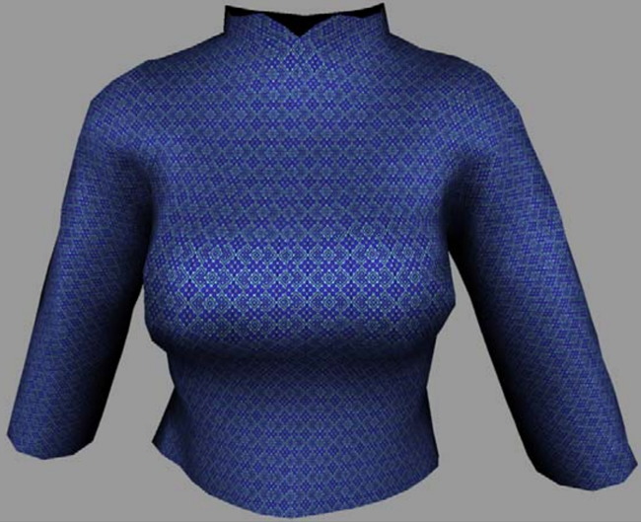
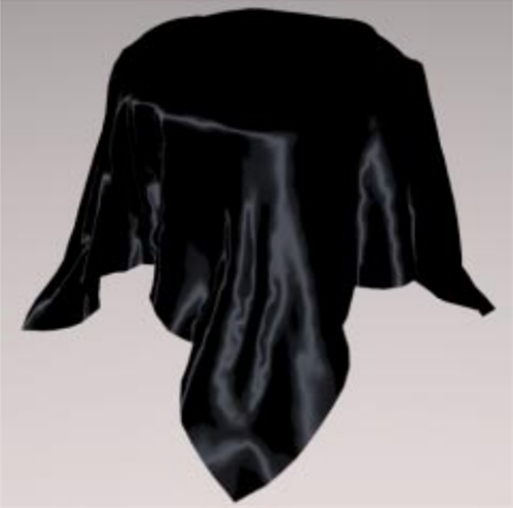
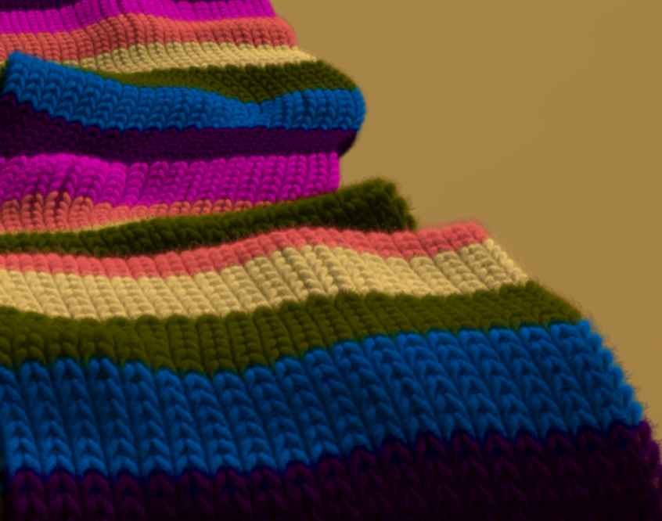
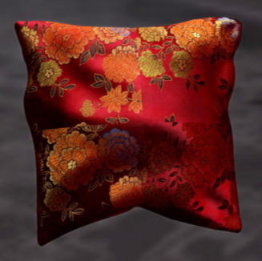
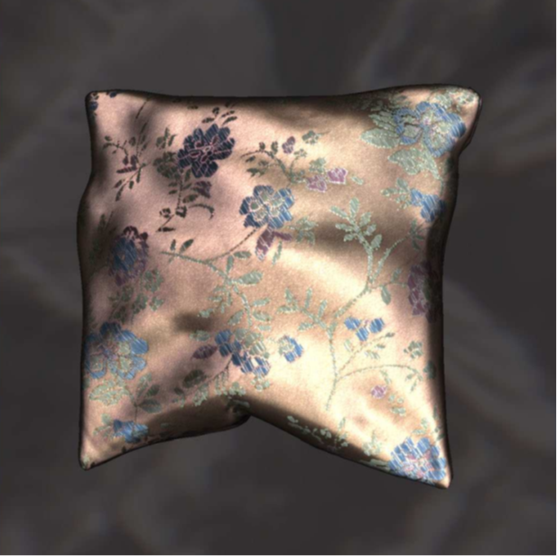
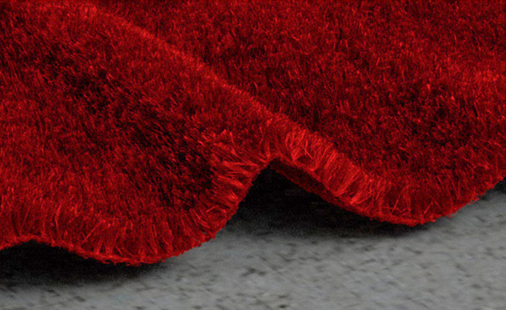
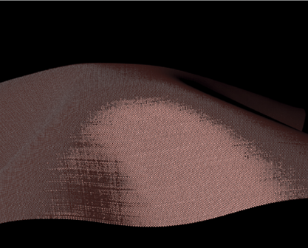
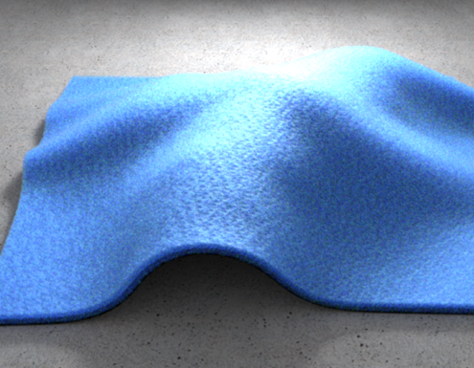
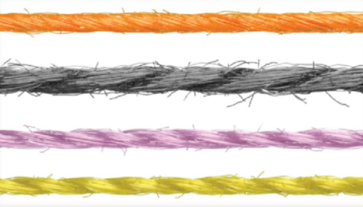
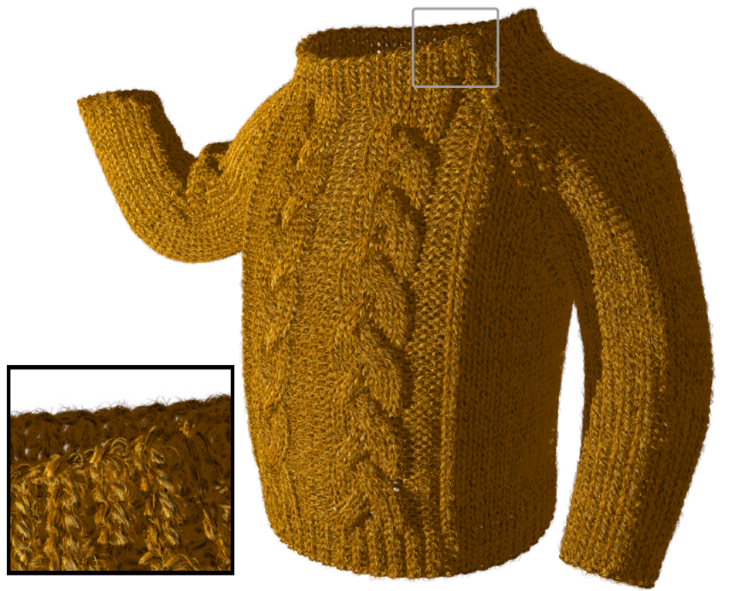
Prior Work
Cloth is hard
[Adabala et al. 1995]
[Ashikhmin et al. 2000]
[Xu et al. 2001]
[Wang et al. 2008]
[Dong et al. 2010]
[Zhao et al. 2011]
[Irawan & Marschner 2012]
[Khungurn et al. 2015]
[Zhao et al. 2016]
[Wu & Yuksel 2017]
Notes:
However, despite decades of research in graphics, high-fidelity predictive rendering of cloth remains challenging.
This is because fabrics generally contain diverse and complex structures which lead to their distinctive appearances.

Slide 4
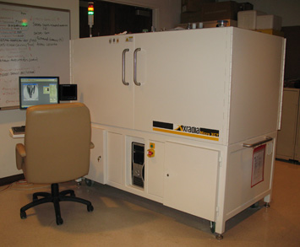
Micro-Appearance Modeling
Micro CT
imaging
Explicit micro-geometry
Richly detailed final appearance
Notes:
During the last few years, we have developed a series of micro-appearance cloth models.
These models offer unprecedented levels of detail and fidelity by leveraging explicit fiber-level cloth geometries [click] which are usually acquired using volume imaging techniques such as computed micro-tomography.

Slide 5
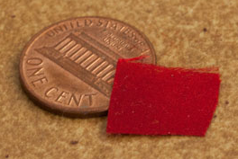
Data-Driven Models
3D volume
Fiber mesh
Data-intensive
Difficult to manipulate
E.g., cannot change from silk to rayon
silk
rayon
GBs of data
Notes:
Previously, these measured geometries are usually described using high-resolution 3D volumes or fiber-meshes.
These data-driven models, however, have a few problems.
First, representing micron-scale geometries takes lots of data.
Second, the lack of high-level information makes these models very difficult, if not impossible, to edit.

Slide 6
Procedural Models
Statistical parameters (22 floats per yarn)
Originated in textile research
Introduced to graphics by Schröder et al. [2015]
Refined by Zhao et al. [2016]
Compact representation
Intuitive editing
E.g., go from silk to rayon by changing parameter values
silk
rayon
a few numbers
Notes:
Fortunately, these problems can be addressed using the procedural model originated in textile research.
This model was first adopted to graphics by Schroder et al. in 2015.
Recently, we have refined this model and shown how to construct them based on physical measurements.
The procedural cloth model describes a fabric’s micro-geometries statistically and is very compact: only 22 floating point numbers are needed to describe a yarn.
And editing can be achieved by simply changing the parameter values.

Slide 7
Problem
Procedural cloth models have to be converted back to data-driven formats to be rendered
For large textiles, the converted models can be extremely data-intensive and impractical to render
Statistical parameters (22 floats per yarn)
(Physically based) renderer
Data-driven model
Too large!
Notes:
However, one major problem remains: physically based rendering of these procedural models generally require them to be converted back into data-drive formats.
At render time, this basically undoes the compactness offered by being procedural.
[Click] Also, large procedural models can become extremely data-intensive when fully realized, making them impractical to render.

Slide 8
Our Work
We introduce a new technique to remove the need to fully convert procedural cloth models to data-driven formats
Our method is exact: it imposes no approximation on the model itself
Our method offers a good balance between run-time storage and performance
Statistical parameters (22 floats per yarn)
Our work
(Physically based) renderer
Balancing run-time storage and performance
Notes:
In this paper, we introduce a new technique to remove the need to fully realize procedural cloth models at render time.
[Click] Our method handles the model exactly by imposing no approximations to the model itself.
[Click] In practice, it offers a good balance between memory consumption and performance.

Slide 9
Our Technique: Overview
Provides a semi-implicit volumetric description
Input: 3D location p
Output: material density and orientation at p
Cloth treated as anisotropic medium [Jakob et al. 2010, Zhao et al. 2011]
Light scatters inside
Can be rendered using volume path tracing with delta tracking
Material density
Fiber orientation
Extinction coeff. Phase function
Notes:
In particular, our method provides a semi-implicit volumetric description for fabrics based on the procedural model.
That is, given a 3D location, our method returns the material properties, including optical density and fiber orientation, at this location.
[Click]
This allows the cloth to be treated as anisotropic participating medium.
Under this formulation, light scatters inside the cloth volume.
Where and how light scatters are controlled by the local material properties.
[Click] These models can be rendered using standard Monte Carlo methods such as volume path tracing with delta tracking.

Slide 10
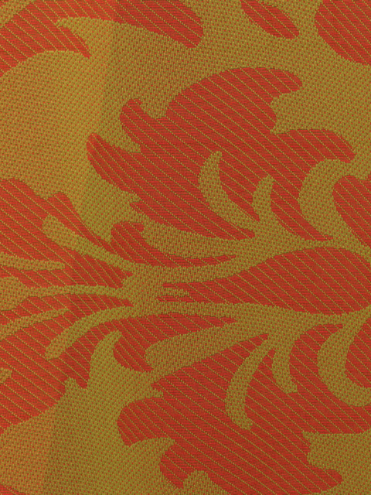
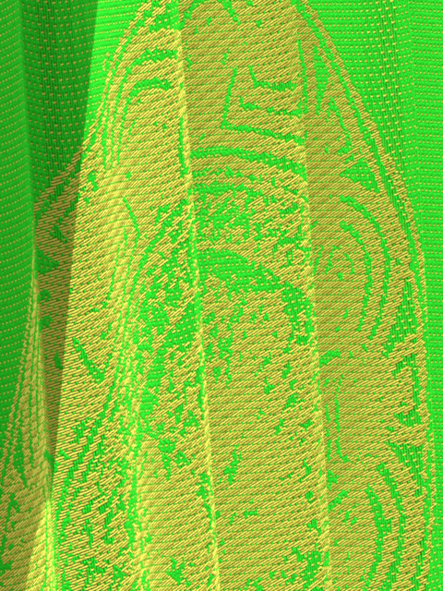
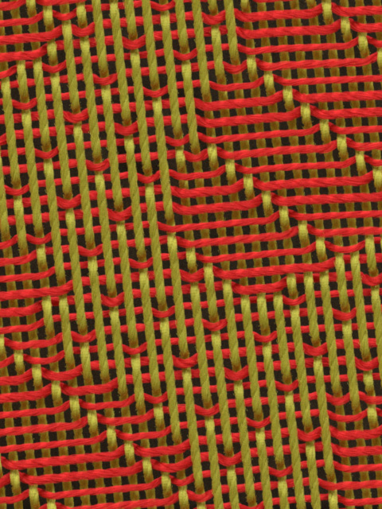
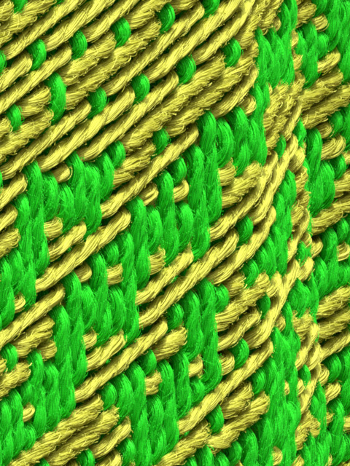
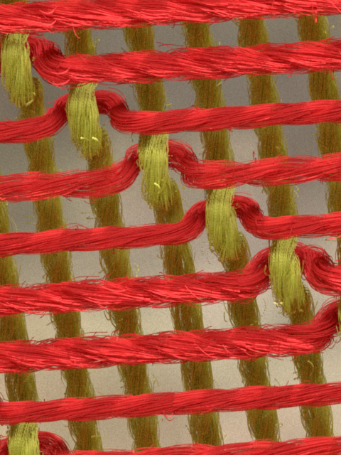
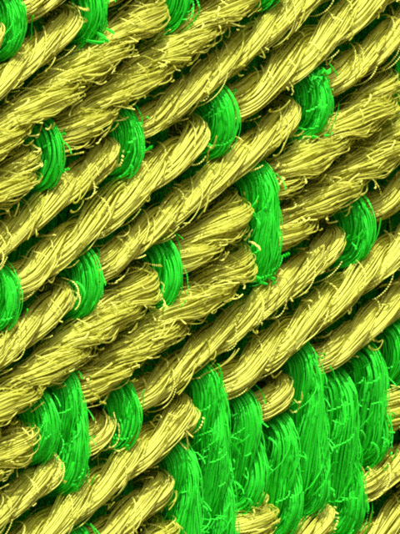
Result (Preview)
33K yarns, 8M fibers
Fully realized: 867 GB Ours: 18.5 GB
10X
10X
100X
100X
400X
400X
Notes:
This is a preview of our result.
This large scene contains 12 highly detailed textiles with fiber-level details as we can see from the zoomed views on the right.
These fabrics contain 33 thousand yarns with 8 million fibers with over 70 billion control points.
Converting all of them into data-driven format takes over 800 GB of storage.
Our method, on the other hand, requires only 18.5 GB of storage, allowing this challenging scene to be rendered with a single workstation.

Slide 11
Background:
Procedural Cloth Modeling
Notes:
Before diving into the details, let me first give a brief recap on procedural cloth modeling.

Slide 12
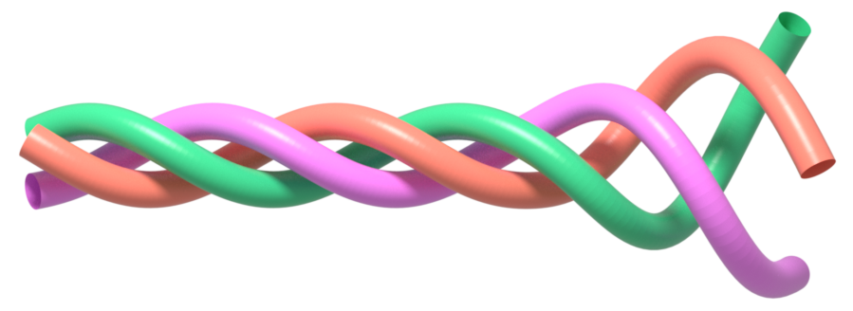
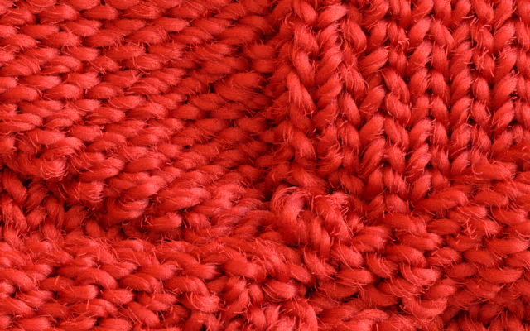
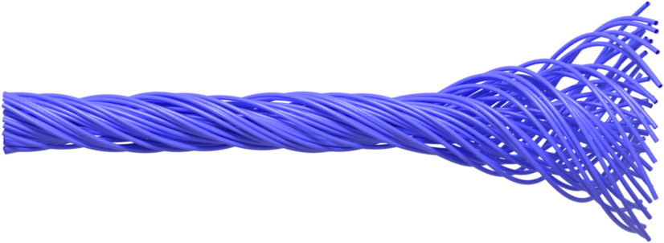
Cloth Structures
Hierarchy of cloth structures
Ply 1
Ply 2
Yarn
Ply 3
Fibers
Cloth
Ply
Notes:
Fabrics are normally composed of yarns via manufacturing techniques like weaving and knitting.
[Click] Each yarn contains several sub-strands called “plies”.
[Click] Each ply in turn consists of tens to hundreds of micron-diameter “fibers”.
The procedural cloth model takes a bottom-up approach starting with forming individual plies.

Slide 13
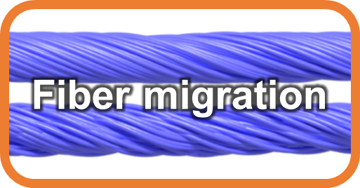
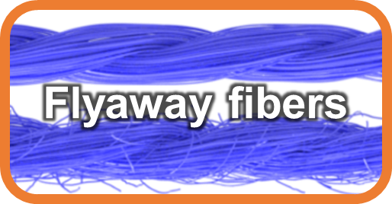
Procedural Ply Formation
Each ply
contained in circular cylinder
Fiber center
Adding irregularities
Ply center
A ply
Ply cross section (a disk)
Notes:
At this stage, each ply is assumed to be contained in a circular cylinder.
[Click] Then, a probability distribution can be used to describe where the fiber centers are in a ply’s cross section.
[Click] To form a ply in 3D, the fiber centers are revolved around the ply center, and their trajectories give individual fiber curves.
As plies formed this way are too perfect looking, [click] additional modifications are then introduced to add irregularities.

Slide 14
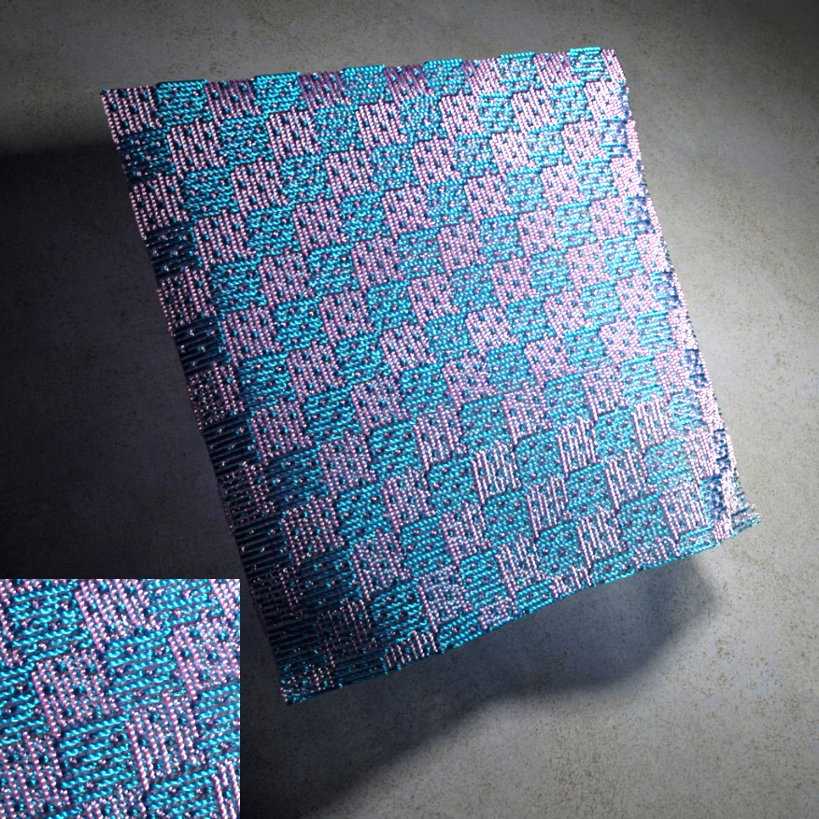
Procedural Yarn and Cloth Formation
A yarn
Multiple yarns
Full textile
Notes:
With the plies generated, multiple of them are then twisted to form a yarn.
[Click] Lastly, many yarns are composed according to some weaving or knitting pattern to form a full textile.

Slide 15
Our Work:
On-the-Fly Procedural Textiles
Notes:
Now, let me provide some details about our technique.

Slide 16
Fabric Space
Defined per textile
Contain multiple yarns with arbitrary center curves
One yarn in the fabric space
Full procedural textiles reside in this space
Notes:
Before describing how our method works, let me first define two spaces since the transformation between them is a key component of our technique.
The fabric space is effectively the object space defined for each fabric.
The yarns in this space are generally curved.
[Click] This is the space in which entire procedural textiles naturally reside.

Slide 17
Yarn Space
Defined per yarn
Contain a single yarn centered at the Z-axis
One yarn in the yarn space:
The procedural yarn model works in this space
Notes:
The other space is the yarn space.
In this space, the yarn is straight and centered around the Z-axis.
[Click] This is the space where the procedural yarn model statistically describes the constituent plies and fibers.

Slide 18
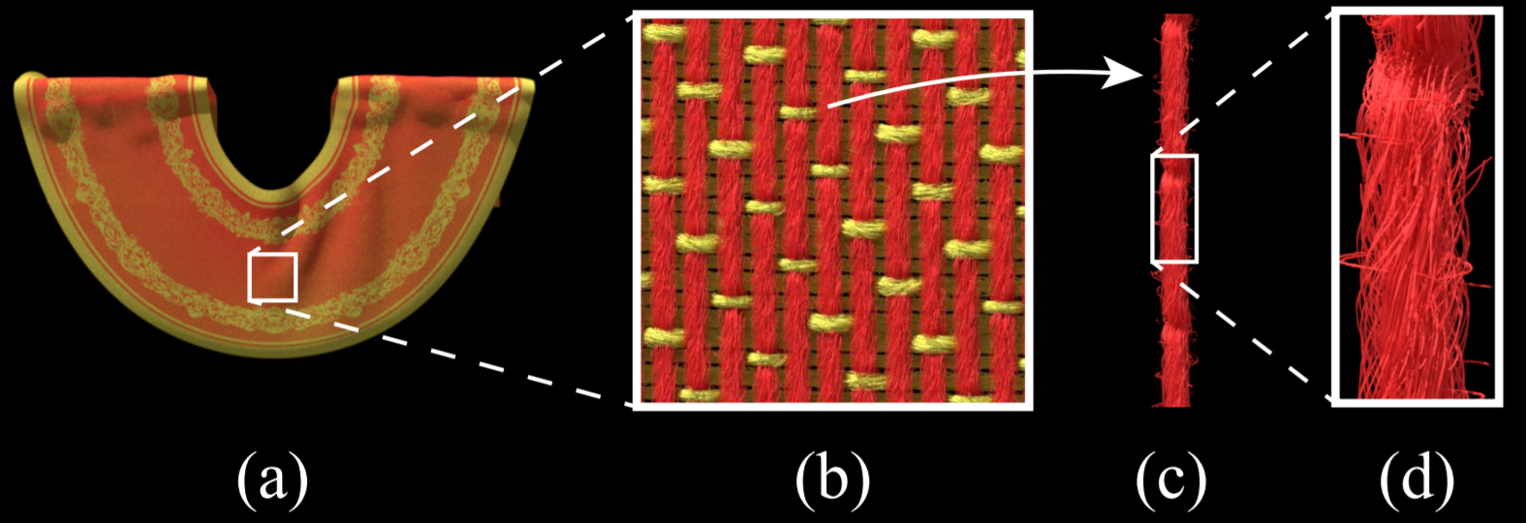
Our Method: Step 1
Given a point p in the fabric space, our method determines which yarn it belongs to and transforms it to the corresponding yarn-space location p’
p’
p
p’
Fabric space
Yarn space
Notes:
With the fabric and yarn spaces defined, we now provide an overview of our approach.
Given a point in the fabric space [click], our method first determines which yarn it belongs to and transform it to the corresponding yarn-space location [click].

Slide 19
Our Method: Step 2
Then, we analyze the procedural model to determine the material properties at p’
Material properties
p’
p’
Yarn space
Notes:
Then, using the yarn-space location, our technique analyzes the procedural yarn model to determine the local material properties needed for rendering.
Next, let me provide more details for both steps.

Slide 20
Step 1: From Fabric Space to Yarn Space
Basic idea
Projecting the query point p onto the yarn curve and obtain q
Arc-length at q determines the cross section containing p
Cross section
p
Yarn center
q
Fabric space
Notes:
The first major step of our approach is to transform a fabric-space location p to its yarn-space counterpart p’.
This can be done by projecting p onto the yarn curve.
Let q denote the projected location, [click] then the arc-length at q determines the cross section that contains p.

Slide 21
Step 1: Transformation
p
p’
Fabric space
Yarn space
See the paper for more details
Notes:
Based on the position of the cross section, we can in turn determine the transformed location p’ in the yarn space.
Please refer to the paper for all the mathematical details.

Slide 22
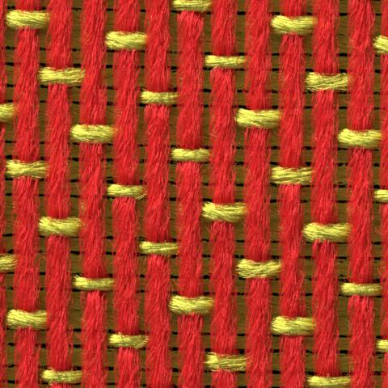
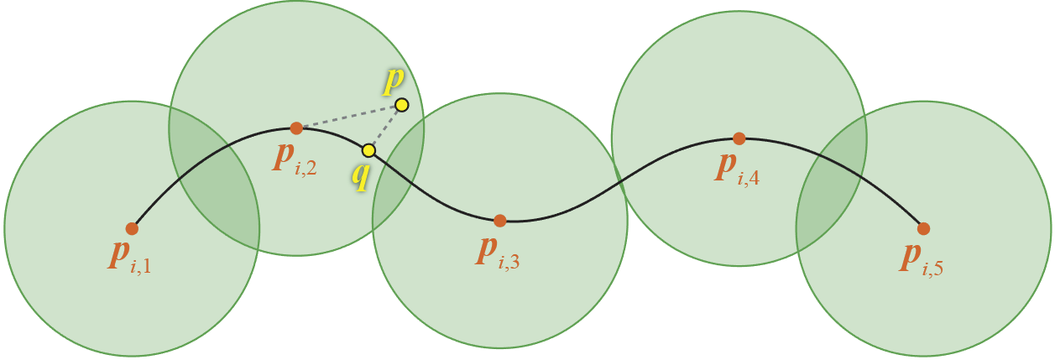
Step 1: Acceleration
Challenge: one fabric can contain hundreds of constituent yarns
We use a customized point Kd-tree to prune faraway yarns
p
p’
Fabric space
Yarn space
Notes:
Since a fabric generally consists of tens, hundreds, or even thousands of yarns, projecting p onto all yarns would be too slow.
[Click]
We use a customized point Kd-tree to quickly prune all yarns that are too faraway.
This Kd-tree contains the control points of all yarn curves.
The basic idea is that if the query point is too faraway from every control point of a yarn, it must be also faraway from the yarn curve itself.
For more details, please see the paper.

Slide 23
Step 2: Determining Material Properties
Key question: is p’ covered by a fiber?
Challenge 1: need to do it efficiently
Challenge 2: need to avoid fully realizing the model
p’
Yarn space
Notes:
With the yarn-space location determined, the second major step of our approach involves determining the local material properties.
The key question needed to be answered is whether the query point p’ is covered by a fiber.
[Click]
Similar to Step 1, we have to do this efficiently.
But unlike the previous step, here we need to avoid pre-generating and storing all fibers.
To achieve this, we carefully analyze the procedural yarn model described earlier.

Slide 24
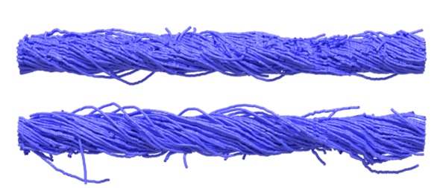
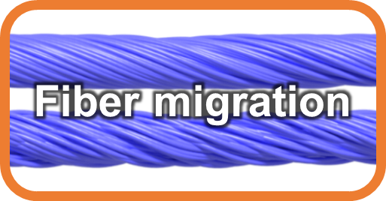
Regular vs. Flyaway Fibers
=
+
All fibers in yarn space
Regular fibers
Flyaway fibers
The procedural model puts all fibers in two categories: regular and flyaway
We check if p’ is covered by each type separately
Notes:
The procedural yarn model puts all fibers in two categories: regular and flyaway.
We check if p’ is covered by each type separately, [click] starting with the regular ones.

Slide 25
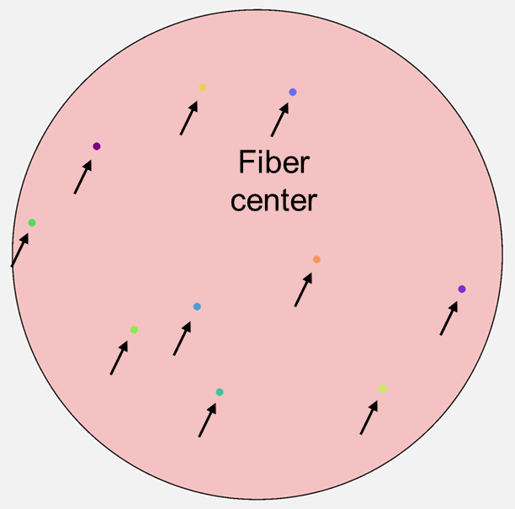
Regular Fiber Lookup
Check if it lies close enough to any fiber center in the cross section
Directly examine the procedural model description
p’
p’
Yarn space
Notes:
To determine if the query point is covered by a regular fiber, we check if it lies close enough to any fiber center in the cross section.
This can be done without fully realizing the model by examining the procedural model description.

Slide 26
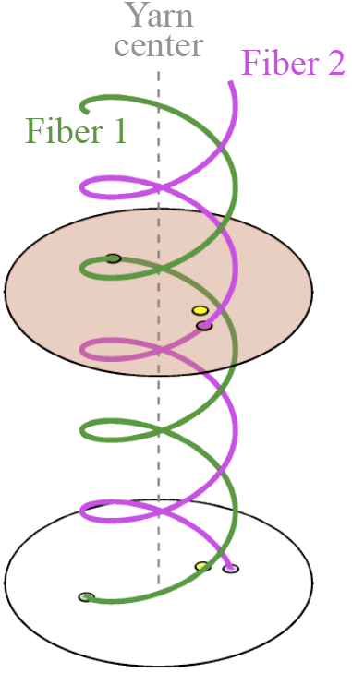
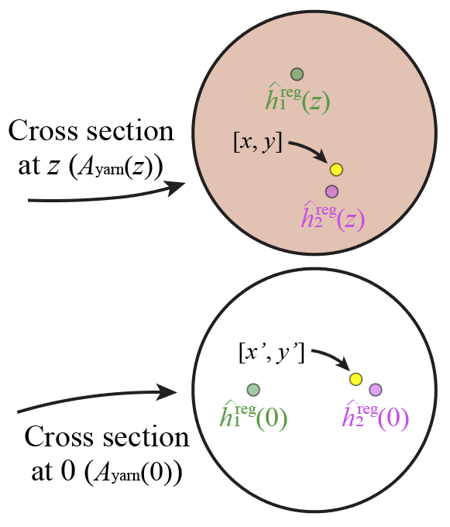
Regular Fiber Lookup
Without fiber migration, each cross section is identical up to a global rotation
p'
p’ covered by a fiber center p’’ covered by a fiber center in the reference plane
p’’
Reference
Notes:
Recall that the regular fibers are created by rotating the cross-sectional centers around the yarn center.
[Click] In this way, when there is no fiber migration, all cross sections will be rotationally invariant.
[Click] This allows us to pre-generate one single “reference” cross section.
Then, the query point p’ is covered by a fiber if and only if an rotated version of it, say p’’, in the reference cross section is also covered.
Notice that storing one cross section per yarn is much cheaper than fully storing all fiber curves.

Slide 27
Handling Migrating Fibers
p'
Fiber centers in the reference cross section:
Points (no migration)
Line segments (w/ migration)
p’’
Reference
Notes:
With fiber migration introduced, the distance from the center of each fiber to the yarn center changes between a minimal and a maximal value in a sinusoidal pattern.
If we rotate all cross sections back to the reference position and stack them into one, the center of each fiber will form a line segment.
In this case, although p’’ touching such a line segment does not necessarily mean the query point is indeed covered by a fiber, we can nevertheless quickly prune all fibers that never get close enough.

Slide 28
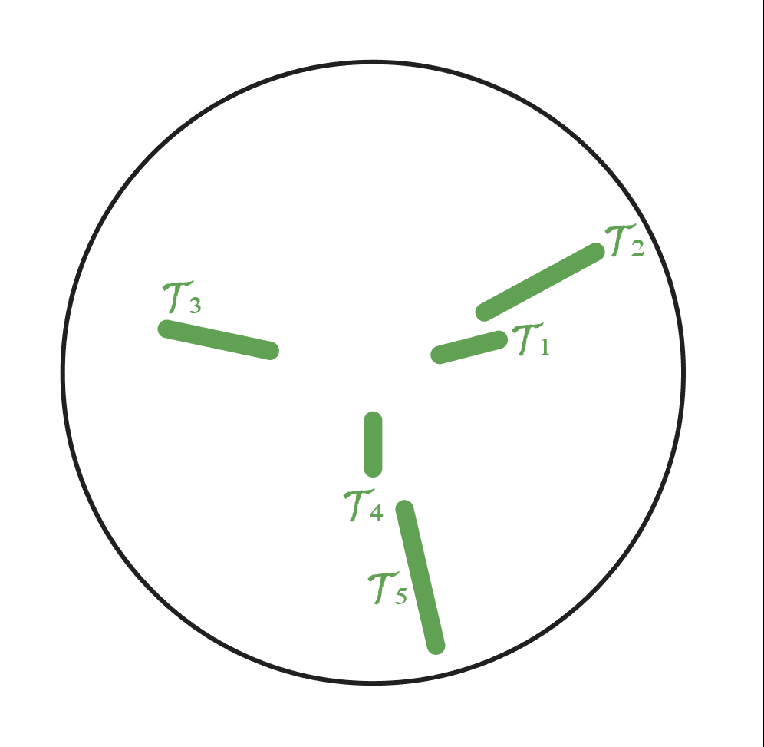
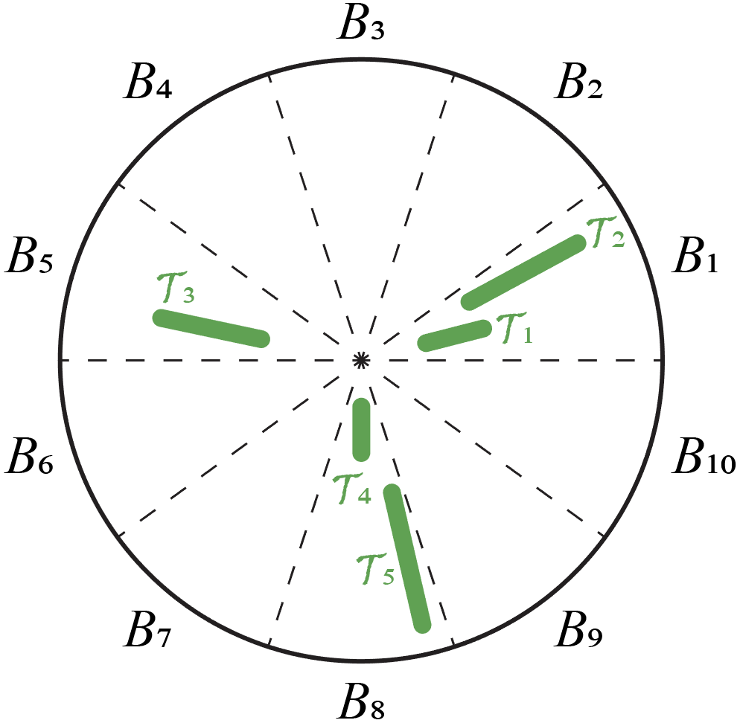
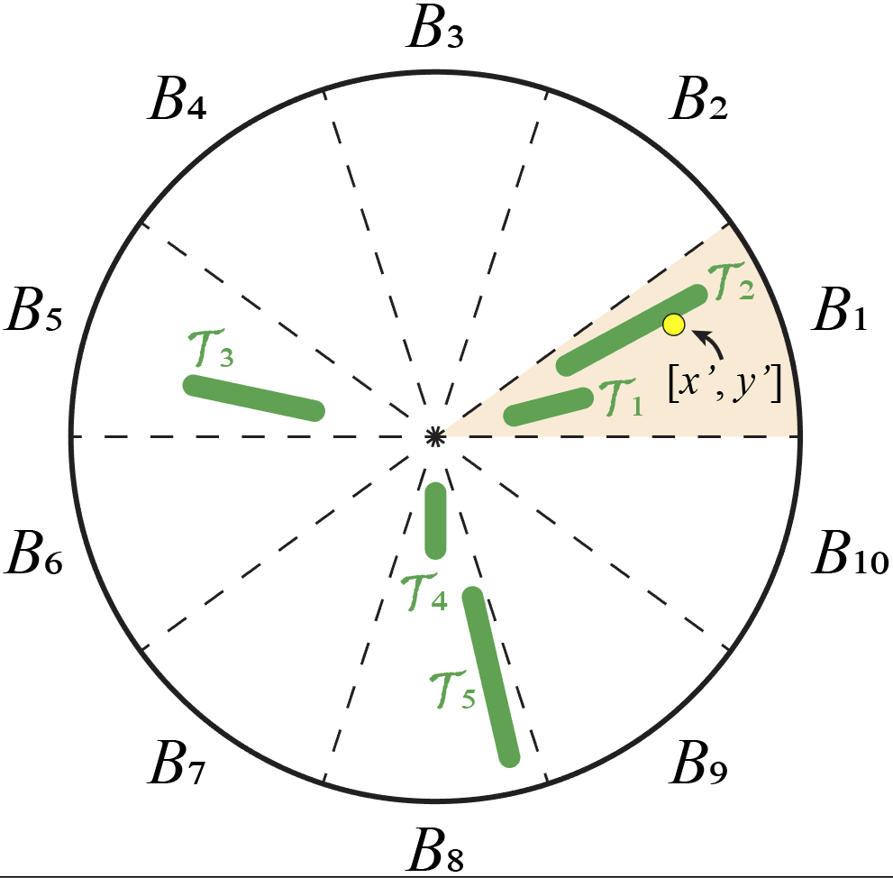
Handling Migrating Fibers
Pre-generate reference cross section with fiber center trajectories
Discretize the cross section
At render time, examine all fibers in the bin that contains the query point p’’
p’’
Notes:
Based on this idea, we pre-generate a reference cross section with the trajectory of each fiber center.
[Click] In addition, we discretize the cross section into a number of bins and assign to each of them intersecting trajectories.
[Click] At render time, given a query point p’’, we then prune all fibers not intersecting the bin containing it.
For the remining ones, we go over them one by one and check if any of them indeed covers the query point.

Slide 29
Regular vs. Flyaway Fibers
=
+
All fibers in yarn space
Regular fibers
Flyaway fibers
The procedural model puts all fibers in two categories: regular and flyaway
We check if p’ is covered by each type separately
Notes:
With the regular fibers out of the way, I will now briefly describe how our method handles flyaway fibers.

Slide 30
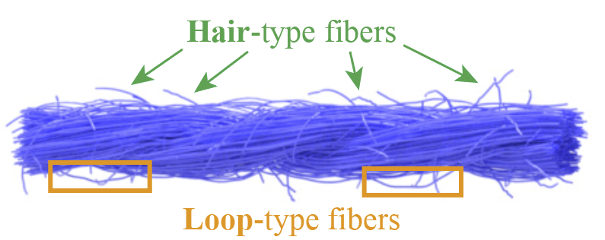
Flyaway Fiber Lookup
Two types of flyaway fibers: hair & loop
Hair fibers: randomly added short “arcs”
Loop fibers: randomly mutated regular fibers
Notes:
There are two types of flyaway fibers captured by the procedural model: hair and loop.
Hair fibers are effectively short “arcs” while the loops are randomly mutated sections of regular fibers.
The distribution of both types are specified by the procedural description.

Slide 31
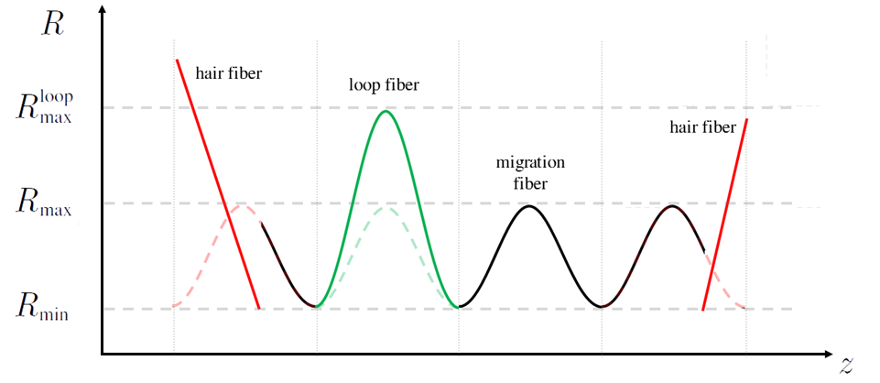
Flyaway Fibers (Side View)
Notes:
Here we show a side view of flyaway fibers in contrast to the regular ones with the hair and loop fibers drawn in red and green, respectively.
Note that although the hair fibers appear straight in this view, they are generally curved in 3D.

Slide 32
Flyaway Fiber Lookup
Loop fibers
Handled by slightly modifying the regular fiber lookup routine
Completely realization-free
Hair fibers
Method 1: completely realization-free (slow)
Method 2: partially realized (more practical)
Notes:
Since the loop fibers are mutated versions of the regular ones, we handle them in a fully realization-free manner by slightly modifying the regular fiber lookup process I showed earlier.
Please see the paper for more details.
[Click]
Hair fibers are more challenging to handle as their spatial distribution is more irregular.
We introduce two ways to do this in the paper.
The first method is completely realization-free, meaning that no additional information needs to be pre-generated and stored.
This approach, however, is fairly slow in practice.
[Click] Next, I will briefly describe our second approach, which we use to generate all paper results.

Slide 33
Handling Hair-Type Fibers
Pre-generate the Z component (i.e., position along the yarn center) per hair
Discretize the Z-axis
At run-time, quickly find all “active” hair fibers associated with the bin containing the query point p’
Notes:
This second approach pre-generates all hair fibers, but only partially.
In particular, we create only their Z coordinates.
In this way, all hair fibers become 1D intervals.
[Click] Then, we discretize the Z-axis using the endpoints of each fiber.
For each discretized segment, we also store the list of fibers covering it.
[Click] At render time, given a query point p’, we can then efficiently retrieve all fibers from the segment containing p’.

Slide 34
Fiber Lookups
=
+
All fibers in yarn space
Regular fibers
Flyaway fibers
If the query point p’ is covered by a fiber, the algorithm returns:
Fiber optical density (specified by the procedural model)
Local fiber tangent
Otherwise, return:
Zero for density
Notes:
This concludes the second major step of our method.
If the algorithm finds that the query point p’ is indeed covered by a fiber, it returns the fiber’s optical density as well as the local tangent direction.
These information can be used by a standard Monte Carlo volume path tracer to render the cloth model.

Slide 35
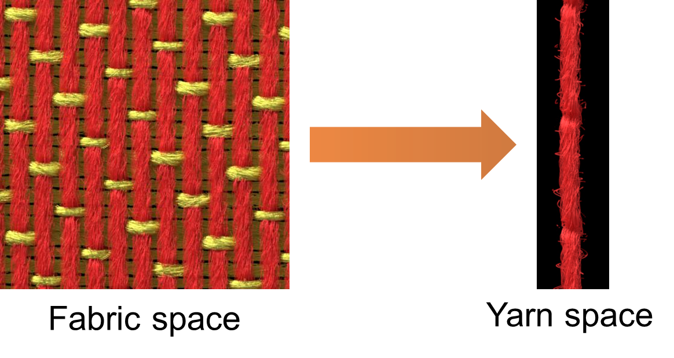
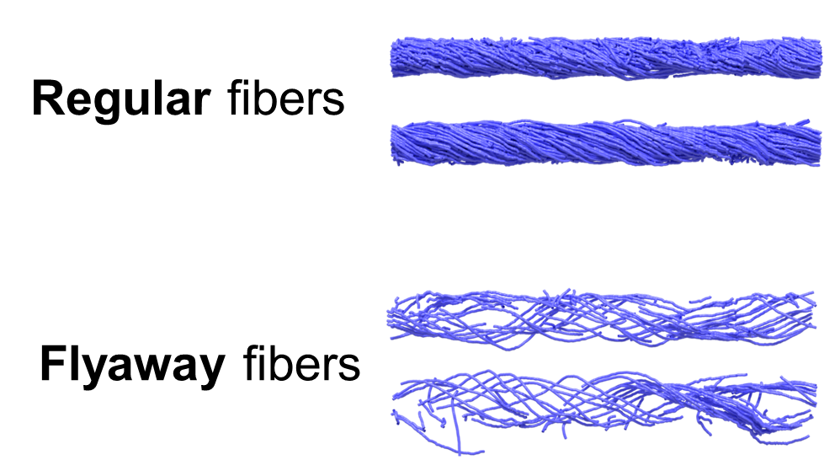
Summary
Step 1:
Fabric to yarn space transformation
Step 2:
Material property retrieval
Notes:
This is a summary of our approach.
We first detect the yarn containing the query point in the fabric space and transform the point into the yarn space.
Then, we check if the yarn-space point is covered by a fiber by examining the procedural model description at render time.
This allows us to compute the material optical properties needed for rendering without fully realizing the entire cloth as an anisotropic medium.

Slide 36
Results
Notes:
Next, let me show some results.

Slide 37
Comparing to Core-Fiber Approximation
Core-fiber approximation
Introduced by Wu and Yuksel [2017]
Approximate a bundle of regular fibers with one displacement mapped pipe
Core fiber
Notes:
Parallel to our work, Wu and Yuksel have recently developed a GPU-based framework for real-time rendering of procedural textiles.
This technique, despite being focused on interactive performance and largely orthogonal to our method, does have some technical components that could be used for physically based rendering.
In particular, a key component of their approach is the core fiber approximation.
This approximation describes a subset of regular fibers using one “large” and displacement-mapped pipe called the core fiber.
This greatly reduces the memory consumption needed to render full textiles.

Slide 38
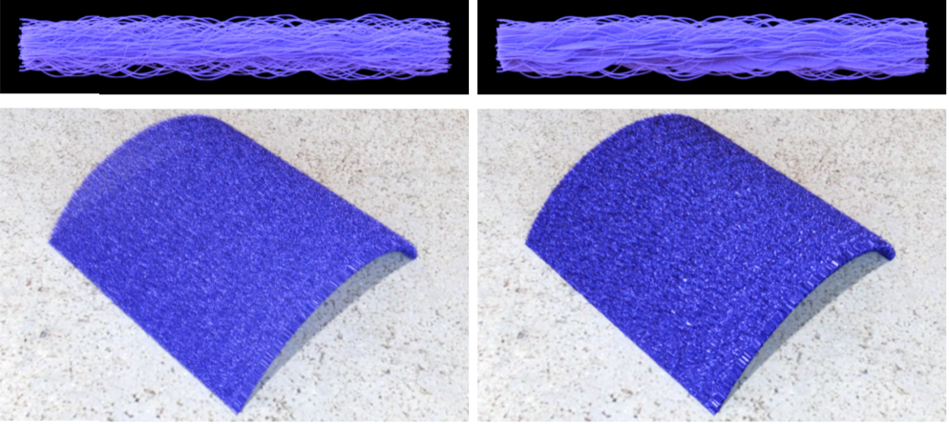
Comparing to Core-Fiber Approximation
Our technique handles the procedural model exactly by imposing no approximation to the model itself
Ours (exact)
Core-fiber approximation
[Wu & Yuksel 2017]
Notes:
Unfortunately, this approximation has a few problem.
One of them is that displacement mapping has difficulties handling overhang structures, which occurs frequently under strong fiber migration.
As we can see in this example, the core-fiber approximation changes the material appearance at both micro and macro scales.
Our method handles the procedural model exactly and enjoys its full accuracy and representative power.

Slide 39
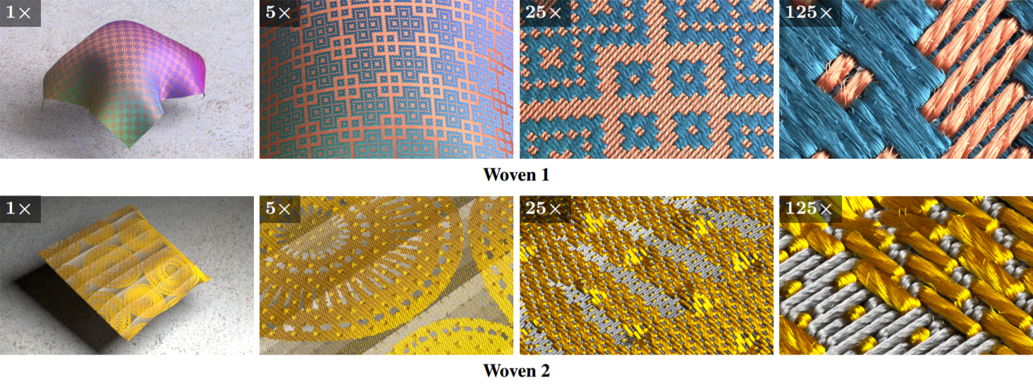
Result: Woven Fabrics
Woven fabric 1: 42.3 GB (fully realized) vs. 189.7 MB (ours)
Woven fabric 2: 36.4 GB (fully realized) vs. 287.7 MB (ours)
Notes:
Here we show two woven fabrics rendered with our method.
When fully realized, both models become very large and challenging to render.
Our method allows these models to be rendered with only a fraction of the space, making the rendering process much more practical.

Slide 40
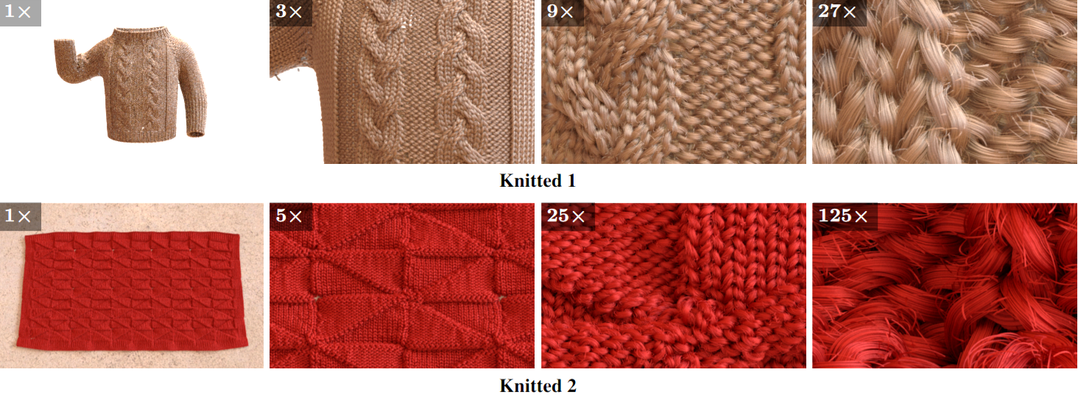
Result: Knitted Fabrics
Knitted fabric 1: 4.2 GB (fully realized) vs. 79.3 MB (ours)
Knitted fabric 2: 14.8 GB (fully realized) vs. 190.1 MB (ours)
Notes:
Here we show renderings of two knitted cloth models.
The complexity of the knitting patterns makes these models hard to describe using existing synthesis-based methods.
Thus, large-scale knitted fabrics have been very difficult to render.
Our technique allows these models to be rendered easily on a single, moderately specced computer.

Slide 41
Result: Sponza (Modified)
33K yarns, 8M fibers
Fully realized: 867 GB Ours: 18.5 GB
10X
10X
100X
100X
400X
400X
Notes:
This is the rendering of the modified Sponza scene I showed earlier.
Now we have seen how our technique allows this challenging scene to be rendered with a single workstation.

Slide 42
Limitations and Future Work
Hair-type fibers: our main bottleneck
Better performance?
Lower storage?
Volumetric only
Supporting fiber-based geometry and BCSDFs
Multi-scale (level-of-detail) support
Generalize to other procedural models
Notes:
Our approach has a few limitations that can hopefully motivate future research.
Firstly, the hair fibers is currently a bottleneck of our method in terms of both performance and storage.
Thus, improving the efficiency for handling these fibers will be very beneficial.
Secondly, our technique currently provides only volumetric model description.
It would be nice if we can extend it to support fiber meshes and BCSDFs.
Thirdly, enabling level-of-detail rendering of detailed procedural textiles is an important topic for future research.
Lastly, it is interesting to see whether the techniques developed in this work can be generalized to handle other procedural models beyond fabrics.

Slide 43
Conclusion
We introduce a new technique to render procedural textiles without full model realizations
Efficient (regular and flyaway) fiber lookup, enabling physically based rendering of large-scale procedural textiles
Statistical parameters (22 floats per yarn)
Our work
(Physically based) renderer
Balancing run-time storage and performance
Notes:
In conclusion, we introduce a new technique to render large procedural textiles without full model realizations.
Our method leverages new algorithms and data structures to look up both regular and flyaway fibers on the fly while storing only a fraction of full model realizations.

Slide 44
Thank you
Funding agencies
NSF CHS 1513967, CHS 1617861
Google
Adobe
AWS Cloud Credits for Research
Project website
http://www.cs.cornell.edu/projects/ctcloth/#proc-egsr17
Notes:
We thank our funding agencies, and thank you for your attention.

