Slide 1
Fitting Procedural Yarn Models for Realistic Cloth Rendering
Shuang Zhao¹ Fujun Luan² Kavita Bala²
¹University of California, Irvine
²Cornell University

Slide 2
Predictive Rendering of Cloth
Important for many applications
Entertainment
Textile design
Online retail
Notes:
Predictive realistic rendering of cloth is important for many applications in entertainment, design, and retail.

Slide 3
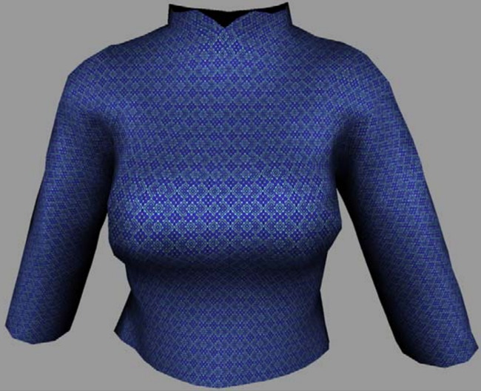
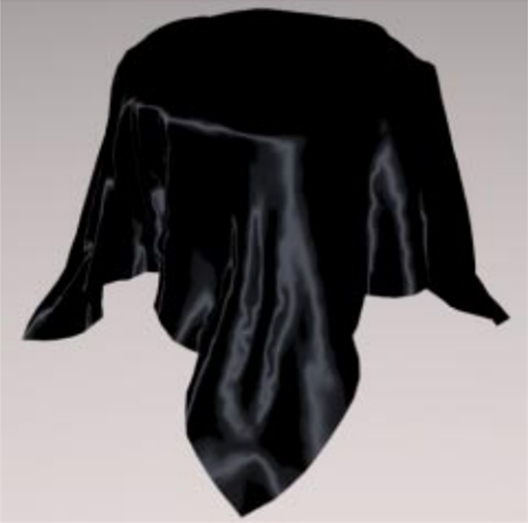
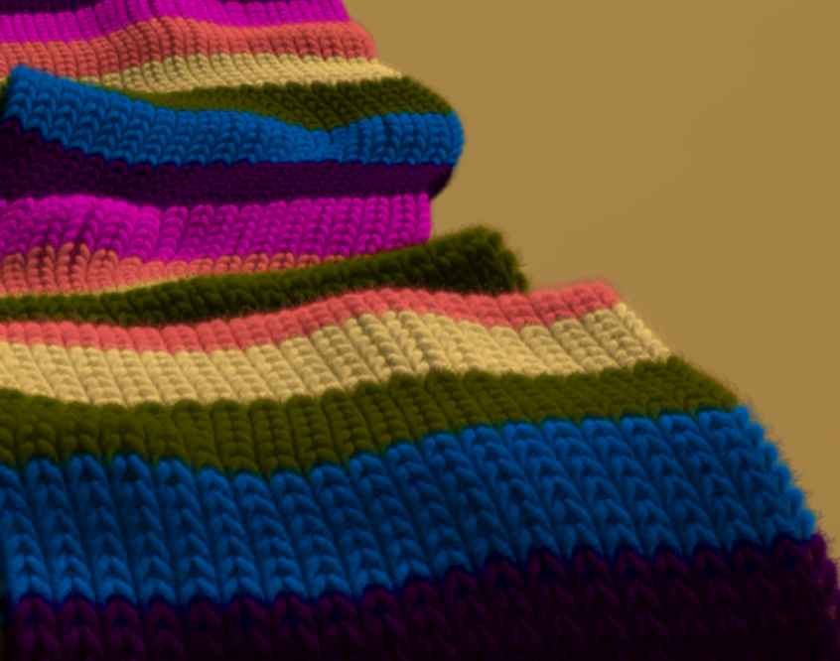
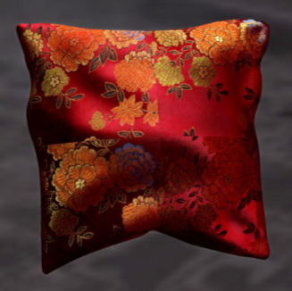
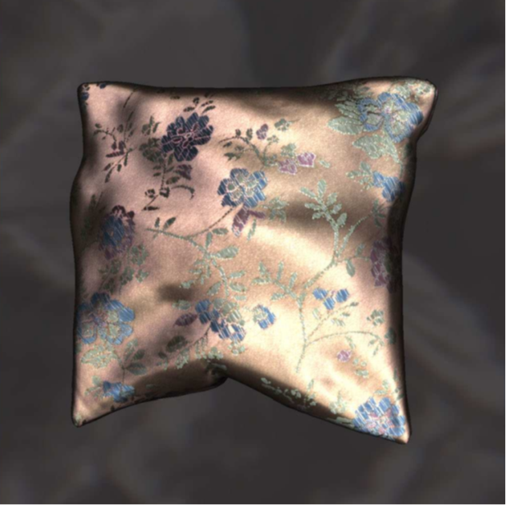
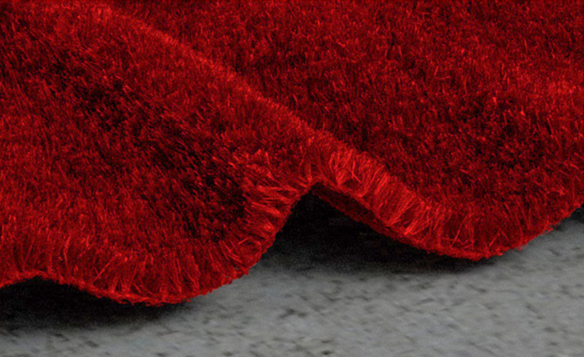
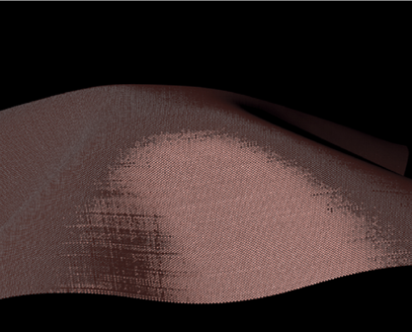
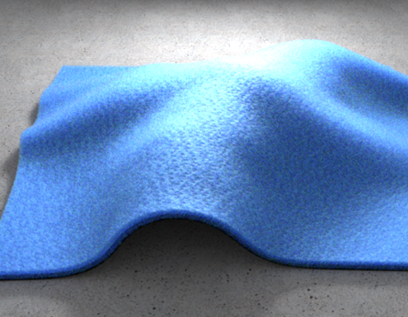
Cloth Rendering in Computer Graphics
Studied for decades in computer graphics
[Adabala et al. 1995]
[Ashikhmin et al. 2000]
[Xu et al. 2001]
[Wang et al. 2008]
Previous paper in this session!
[Dong et al. 2010]
[Zhao et al. 2011]
[Irawan & Marschner 2012]
[Khungurn et al. 2015]
State-of-the-art quality: micro-appearance models
Notes:
Therefore, it has been an active research topic in graphics for decades.
[Click]
During the last few years, we have developed a series of micro-appearance cloth models, which have brought the quality of rendered cloth to a next level.

Slide 4
Micro-Appearance Cloth Models
Explicit micro-geometry
Richly detailed final appearance
Highly realistic even at extremely zoomed levels
Notes:
These models leverage explicitly described fiber-level geometry to produce richly detailed cloth appearance.
[Click] These details are crucial for producing realistic results at close-up views.

Slide 5
Micro-Appearance Cloth Models
Explicit micro-geometry
How are the micro-geometries obtained and described?
Notes:
But how are the micro-geometries obtained & described in the first place?

Slide 6
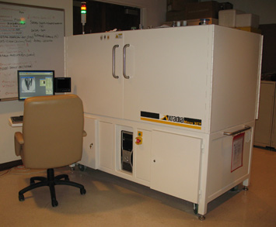
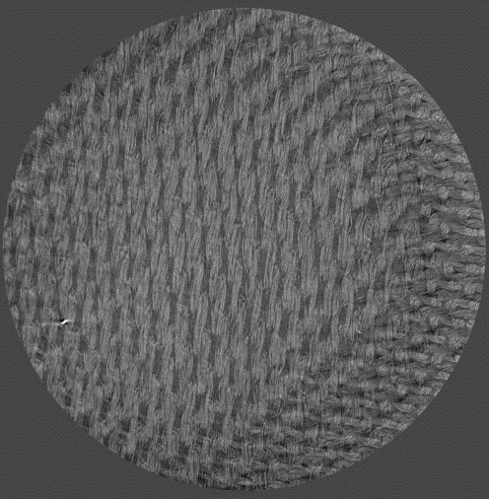
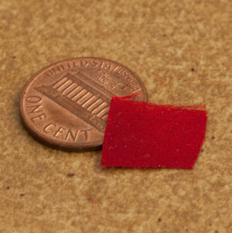
Data-Driven Micro-Geometry
Silk satin
Physical sample
Measured geometry
Computed micro-tomography (micro CT) scanner
Notes:
As seen in the previous talk, one common approach is data-driven.
That is, the micro-geometry is directly measured using volume imaging, such as micro CT.

Slide 7
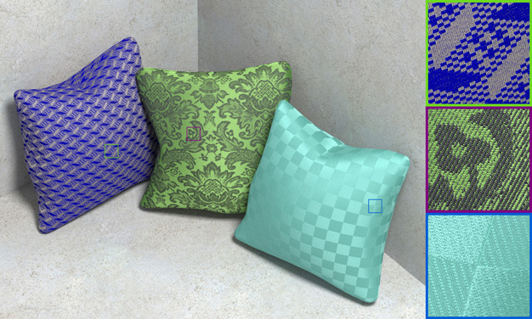
Data-Driven Micro-Geometry
Volumetric
Fiber-based
3D volumes with per-pixel:
Fiber density
Fiber direction
Explicit fiber curves (polylines)
Highly realistic renderings
[Zhao et al. 2011, Zhao et al. 2012, Khungurn et al. 2015]
[Khungurn et al. 2015]
Notes:
By processing the measured data, the final model can be either volumetric or fiber-based.
[Click] Both models have been able to produce highly realistic renderings.

Slide 8
Data-Driven Micro-Geometry: Problems
Data-driven models
Data-intensive
Difficult to manipulate
Problems
E.g., cannot change from silk to rayon
GBs of data
silk
rayon
(Instancing required)
Notes:
Unfortunately, there are some problems with these data-driven models.
[Click]
First, representing micron-scale geometries takes lots of data.
For instance, the volumetric model for this small piece of silk needs multiple gigabytes of storage.
Therefore, data-driven models rely heavily on instancing when representing normal-sized objects.
This can cause noticeable repeated patterns or seams.
[Click]
Another problem is the lack of high-level information, which makes the data-driven models difficult to edit.
For example, it is almost impossible to turn a CT scanned silk into rayon.

Slide 9
Procedural Micro-Geometry
Statistical parameters
Originated in textile research
Adopted to graphics by Schröder et al. [2015]
Procedural models
Data-intensive
Compact representation
Difficult to manipulate
Intuitive editing
E.g., cannot change from silk to rayon
E.g., go from silk to rayon by changing parameter values
silk
rayon
GBs of data
silk
rayon
a few numbers
(Instancing required)
(NO instancing needed)
Notes:
Procedural models ease these problems.
[Click] Originated in textile research and adopted by Schroder et al, these models describe micro-geometries statistically.
[Click] Thus, they offer compact representations: only a few distributional parameters need to be stored.
[Click] And editing can be achieved by simply changing parameter values.

Slide 10
Procedural Micro-Geometry: Problem
Statistical parameters
Procedural models
Difficult to set parameter values
Previous model creation
Manual
Experienced user only
Time-consuming
Model parameters
Real-world cloths
Notes:
However, the procedural models are not without problem.
Due to high model complexity, it is difficult to determine model parameter values to match real-world micro-geometries.
[Click] Previously, the model creation process is manual, requires high user expertise, and can be time-consuming.

Slide 11
Our Work
Statistical parameters
Our work
Procedural models
Statistical parameters
Data-driven models
Procedural models
Notes:
Our work takes a first step to bridge the gap between the two models.
[Click] In particular, we fit procedural models to data-driven ones.

Slide 12
Our Contributions
Parameter fitting algorithm
Improved flyaway fiber model
compact representation
Our models enable
(22 floats per yarn type)
intuitive editing
Notes:
Our contributions include a novel parameter fitting algorithm.
[Click] We also improve the model itself by introducing a new way to describe flyaway fibers.
[Click]
Our fitted models are highly compact: for each type of yarn, only 22 floating numbers are needed.
The models can also be easily edited.

Slide 13
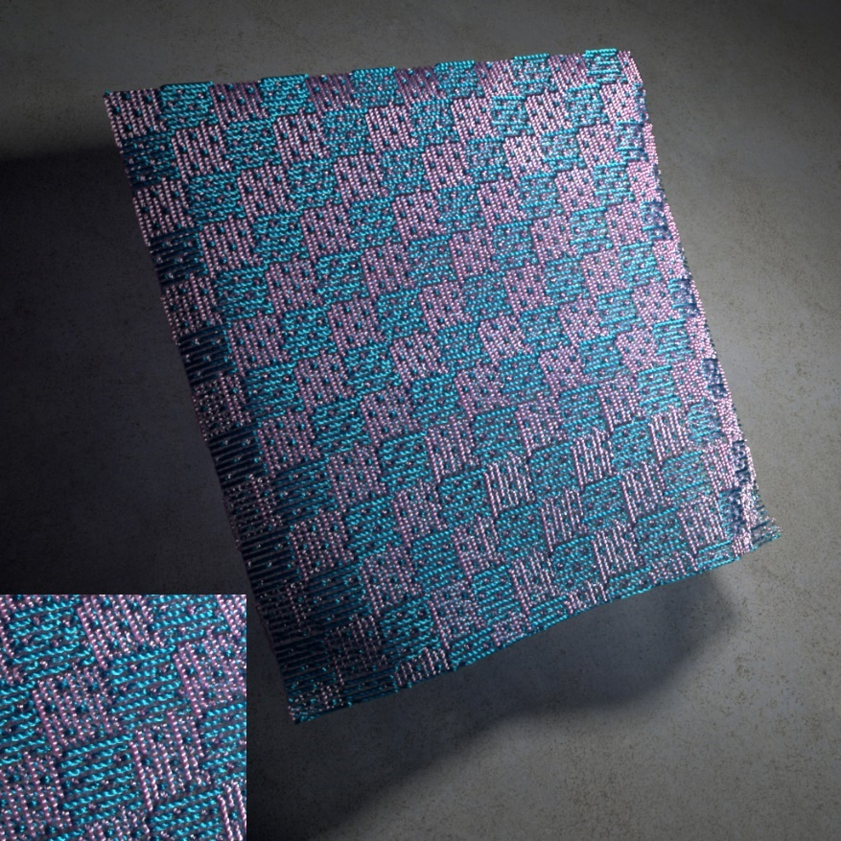
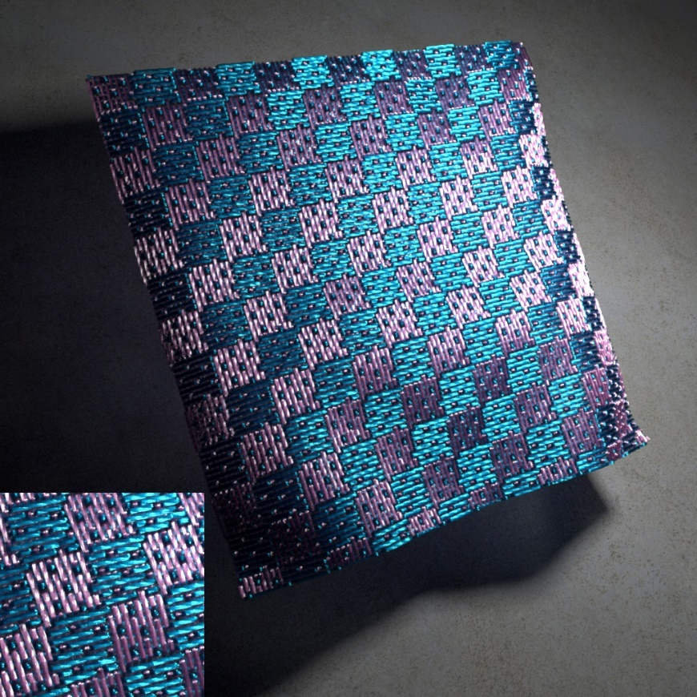
Results (Preview)
Silk 1
Silk 2
≈
≈
Fitting
Photograph
Rendered with our model
Photograph
Rendered with our model
Original
Edited
Editing
Notes:
Here we show a preview of our results.
Procedural models fitted with our approach closely match the reality.
[Click]
Here we show an edited example for a woven fabric created with two silk yarns shown on the left.
[Click] By adjusting one parameter value so that the fibers are better aligned, [click] the entire cloth becomes glossier.

Slide 14
Background: Procedural Cloth Model
Notes:
We now give a brief recap on procedural cloth modeling.

Slide 15
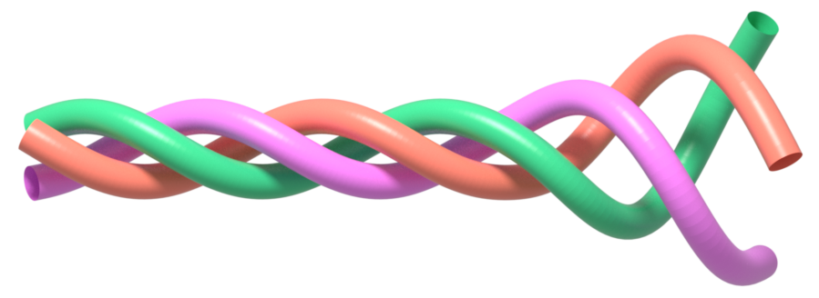
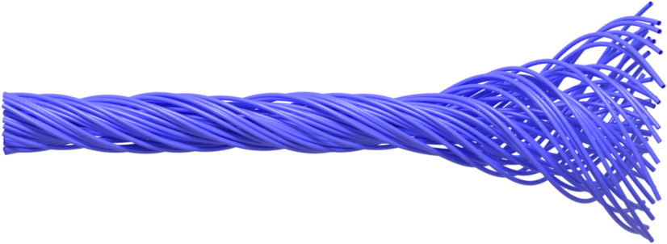
Yarns, Plies, and Fibers
Ply 1
Yarn
Ply 2
Ply 3
Model procedurally
Ply
Fibers
Notes:
Fabrics are normally composed of yarns via manufacturing techniques like weaving and knitting.
Each yarn contains several sub-strands called “plies”.
[Click] Each ply in turn consists of tens to hundreds of micron-diameter “fibers”.
[Click] In this paper, we focus on procedurally describing individual yarns.

Slide 16
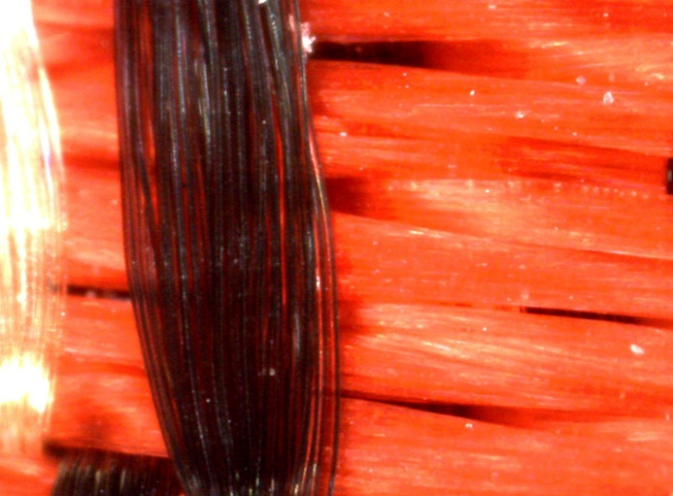
Procedural Yarn Generation
Ply 1
Step 1: Ply formation
How fibers are combined to form a ply
Ply
Yarn
Fibers
Ply 2
Ply 3
Ply 1
Fiber-level details are important for realistic close-up appearance
Step 2: Yarn formation
How plies are combined to form a yarn
Yarn
Ply
Fibers
Ply 2
Ply 3
Notes:
To achieve this, one needs to describe:
how plies are formed with fibers;
and how a yarn is formed with plies.
[Click] Having fiber-level details is important for realistic appearance at close-up views.

Slide 17
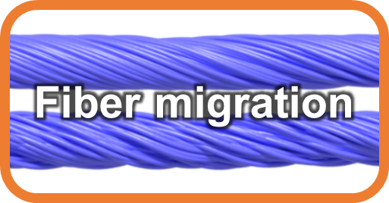
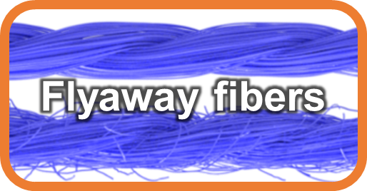
Ply Formation
Each ply
Fiber-level params
contained in circular cylinder
Fiber center
Adding irregularities
Ply center
A ply
Ply cross section (a disk)
Notes:
When describing fibers within a ply, it is convenient to assume the ply to be contained in a circular cylinder.
[Click] Then, a probability distribution can be used to describe where the fiber centers are in a ply’s cross section.
[Click] To form a ply in 3D, the fiber centers are revolved around the ply center, and their trajectories give individual fiber curves.
As plies formed this way are too perfect looking, [click] two extra sets of parameters are used to introduce irregularities.
I will describe them in more details later.
[Click] Fiber distribution, migration and flyaway fibers are the three ingredients for procedural yarn modeling at the fiber-level.

Slide 18
Procedural Yarn Model
Step 1: Ply formation
How fibers are combined to form a ply
Ply
Fibers
Ply 1
Step 2: Yarn formation
How plies are combined to form a yarn
Yarn
Ply 2
Ply 3
Notes:
After obtaining individual plies, we then need to combine them to form a yarn.

Slide 19
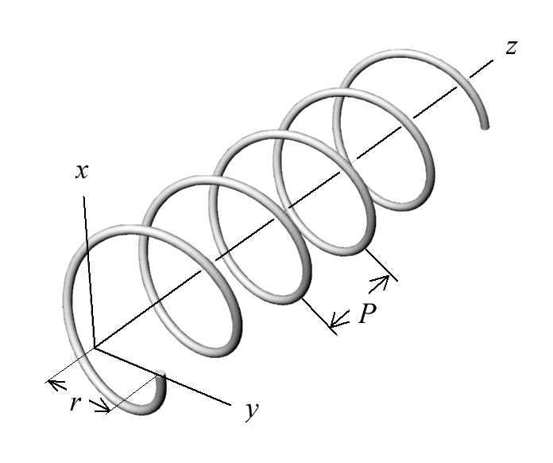
Yarn Formation
Ply-level parameters
(shared by all plies)
Ply cross section
Ply twisting
yarn center
Circle
Ply 1
Yarn
Ply 2
Ellipse
Ply 3
(Simulating the compression of plies)
Notes:
The first step in yarn formation is deforming the previously generated plies to have elliptical cross sections.
The purpose of this step is to simulate ply compression, a common phenomenon in reality.
[Click] Finally, each compressed ply is twisted around the yarn center.
[Click] The deformed ply cross section and ply twisting are the two ply-level parameters for procedural yarn modeling.
[Click] Since most real yarns contain identical plies, we assume these parameters to be shared by all plies.

Slide 20
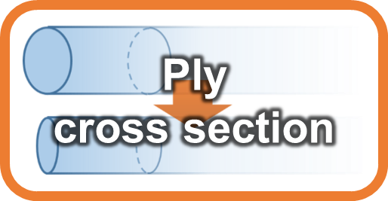
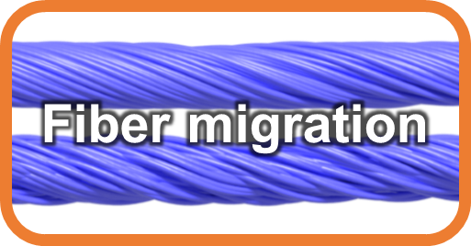
Summary
Procedural yarn generation
Fibers
Ply formation
Plies
Yarn formation
Yarns (results)
… …
(5 parameters)
A ply
Challenge: hard to determine parameter values
22 parameters in total
(17 parameters)
Notes:
This is a summary of the procedural yarn generation process.
The plies are first generated by revolving fibers centers and adding irregularities.
[Click] Then, the plies are compressed and twisted to create resulting yarns.
[Click]
Although this model has remarkable representative power, its high complexity makes determining parameter values difficult.

Slide 21
Our Work: Fitting Procedural Yarn Models
Notes:
Motivated by this challenge, we develop an end-to-end pipeline to fit procedural yarn models to physical measurements.

Slide 22
Procedural yarn generation
Fibers
Ply formation
Plies
Yarn formation
Yarns (results)
Input
Input
… …
We invert this process for model fitting
Notes:
Our main idea is to invert the yarn generation process.

Slide 23
Overview
Fibers
Fiber-level fitting
Plies
Ply-level fitting
Yarns (input)
Measured yarn geometry
Output
Output
Physical samples
Untied plies
Notes:
In particular, we measure physical yarns and use the obtained geometry as input.
[Click] We start with recovering the ply-level parameters and [click] undoing the yarn formation step to obtain “untied” plies that have compression and twisting removed.
[Click] Using these untied plies, we then fit the fiber-level parameters, completing the procedural model.
[Click] Now, let’s take a closer look at how the input yarn geometry is obtained.

Slide 24
Acquisition of Yarn Geometry
Our acquisition setup
Micro CT [Zhao et al. 2011]
Previous paper!
Fiber density & orientation
[Zhao et al. 2012]
Extracted fiber curves
Tracked ply centers
Notes:
We CT scan a few yarns to measure their geometries.
[Click] For each yarn, fiber density & orientation information can be obtained by processing the CT data.
[Click] Then, we use the fiber extraction technique described in the previous talk to extract the fiber curves.
[Click] Also, the ply centers are recovered using a tracking technique we developed in 2012.

Slide 25
Ply-Level Fitting
Fibers
Fiber-level fitting
Plies
Ply-level fitting
Yarns (input)
Measured yarn geometry
Output
Output
Physical samples
Untied plies
Notes:
With the extracted fiber curves and ply centers, we then start our ply-level fitting step.

Slide 26
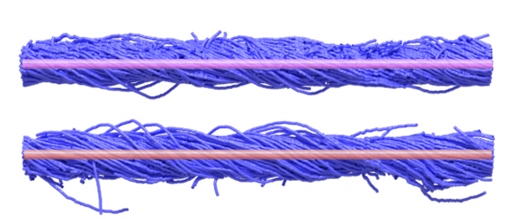
Ply-Level Fitting: Outline
Extracted fiber curves and ply centers
Untied plies (straight, circular)
Shared by all plies
Notes:
In this step, we obtain ply twisting and cross section which are then used to undo the yarn formation process.
Let me show how to recover the ply-level parameters, … (starting with ply twisting)

Slide 27
Ply-Level Fitting: Ply Twisting
Ply curves modeled as circular helices
Approximating polylines with helices
Parameters: radius and pitch
Ply-level params
Circular helices
Input ply centers (polylines)
Our solution: minimizing L2 difference
Solved using the standard Nelder-Mead Simplex Method
Notes:
…, starting with ply twisting.
Because the ply centers are modeled as helices, computing ply twisting boils down to approximating the input ply centers using helices.
[Click] We determine the corresponding radius and pitch values by minimizing the L2 difference to the input.
We solve this optimization using the standard simplex method, although more advanced solution techniques are possible.

Slide 28
Ply-Level Fitting: Ply Cross-Section
Ply cross sections modeled as ellipses
Need: lengths of (major/minor) axes
Ply-level params
Input ply centers
Yarn cross section
(3-ply example)
Notes:
With ply twisting recovered, the remaining task is to compute the plies’ cross-sectional shape.
Since the cross sections are modeled as ellipses, we need to find the lengths of their major and minor axes.
[Click] Given a cross section, we first assign each fiber center to the nearest ply.
[Click] Here we show a 3-ply example.

Slide 29
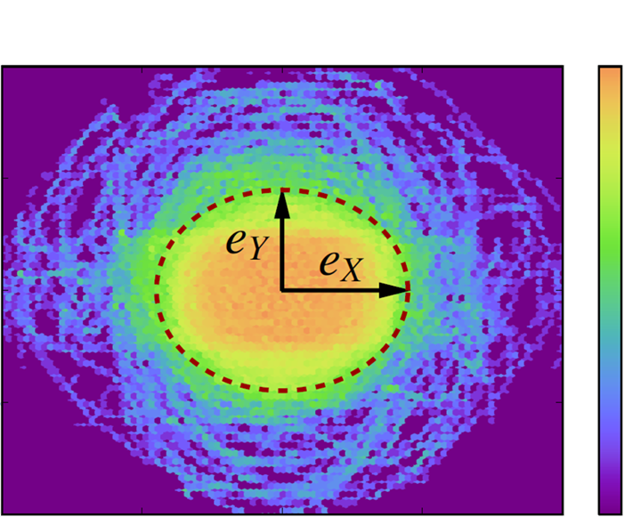
Ply-Level Fitting: Ply Cross-Section
Ply cross sections modeled as ellipses
Need: lengths of (major/minor) axes
Ply-level params
High
Input ply centers
Stack
95%
Yarn cross section
(3-ply example)
Stacked fiber centers
Low
Notes:
Then, we align each ply and stack all fiber centers.
After merging the stacked fiber centers from all cross sections, [click] a 2D density map can be obtained.
We fit an ellipse covering [click] roughly 95% of the total density as the shape of ply cross sections.
For more details, please see the paper.

Slide 30
Ply-Level Fitting: Post-Processing
Ply-level params
Extracted fiber curves and ply centers
Untied plies
Untied plies: straight, circular
Ready for fiber-level fitting
Notes:
With both ply-level parameters in hand, we “untie” the input plies so that the results become straight and with circular cross sections.
[Click] These untied plies are now ready to be used for fiber-level fitting.

Slide 31
Fiber-Level Fitting
Fibers
Fiber-level fitting
Plies
Ply-level fitting
Yarns (input)
Measured yarn geometry
Output
Output
Physical samples
Untied plies
Notes:
The goal for our fiber-level fitting step is to obtain the three ingredients used in ply formation.

Slide 32
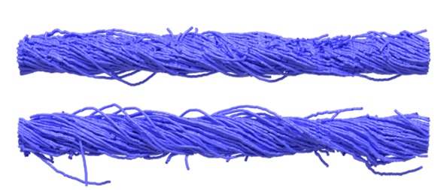
Fiber-Level Fitting: Outline
Measured yarn geometry
Ply-level fitting
=
+
All fibers in untied plies
Regular fibers
Flyaway fibers
Notes:
To achieve this, we first put all fibers from the untied plies into two categories: regular and flyaway.
The regular fibers are then used to estimate fiber distribution & migration;
and the flyaway ones are used to fit our improved model.

Slide 33
Fiber-Level Fitting: Fiber Classification
Measured yarn geometry
Ply-level fitting
=
+
All fibers in untied plies
Regular fibers
Flyaway fibers
Notes:
Next I will give more details about both steps, starting with fiber classification.

Slide 34
Distance-Based Fiber Classification
A fiber
d_{max}
d_{min}
Ply center
d_{min} “small”, d_{max} “large”: flyaway fibers
d_{min}, d_{max} both “large”: alien material (e.g., dust)
d_{min}, d_{max} both “small”: regular fibers
Notes:
We classify each fiber as regular or flyaway based on its minimal and maximal distance to the ply center.
[Click] When both distances are large, the fiber has stayed faraway from the center.
This is usually the case for alien materials such as dust, and the fiber is simply ignored.
[Click] When both distances are small, the fiber is considered regular.
[Click] Finally, when the minimal distance is small but the maximal is large, the fiber is likely to be flyaway.
Please see the paper for how the distance thresholds are determined.

Slide 35
Fiber-Level Fitting: Fiber Classification
Measured yarn geometry
Ply-level fitting
=
+
All fibers in untied plies
Regular fibers
Flyaway fibers
Notes:
With regular and flyaway fibers in hand, we can start estimating the fiber-level parameters.

Slide 36
Fiber-Level Fitting: Regular Fibers
Measured yarn geometry
Ply-level fitting
=
+
All fibers in untied plies
Regular fibers
Flyaway fibers
Notes:
We use regular fibers to recover distribution as well as migration parameters.

Slide 37
Recap: Ply Generation
Introducing irregularities
A ply
Regular fibers
+
Regular fibers
Notes:
Recall that a ply is formed by revolving a number of cross-sectional fiber centers with added irregularities.

Slide 38
Regular Fiber Fitting: Overview
Inverting the ply generation process
Removing irregularities
Introducing irregularities
+
Regular fibers
Regular fibers
Notes:
To obtain fiber distribution & migration, we invert this process.
That is, we first estimate fiber migration which is used to remove the added irregularities.
The resulting fibers are then used to compute fiber distribution.
Let me give some more details on both steps.

Slide 39
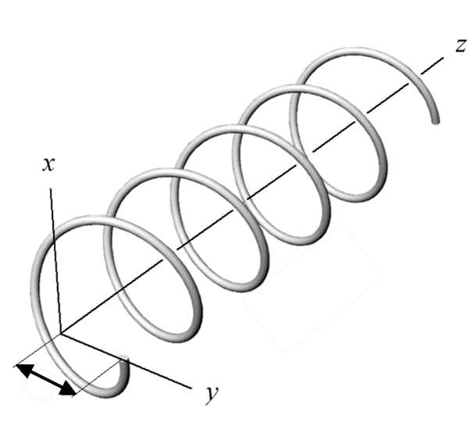
Fiber Migration
No migration:
stays constant
Fiber-level params
Fibers modeled as helices
With migration:
R changes between $R∙r_{min}$ and $R∙r_{max}$ with period s
R
$$R∙r_{max}$$
R
R
$$R∙r_{min}$$
z
s
Notes:
Our procedural model treats fibers as circular helices.
[Click] Without migration, “big R”, the distance between a fiber center to the ply center stays constant.
[Click] With migration introduced, on the other hand, “big R” alters between a minimal and a maximal value with a sinusoidal pattern.
Three parameters are used to characterize this effect:
r_min and r_max are two scaling factors determining the internal in which “big R” changes;
s specifies the length of one cycle.

Slide 40
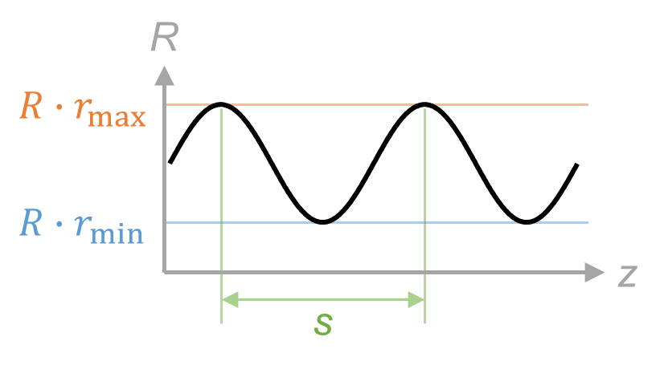
Fiber Migration Fitting
Goal: solving
r_{min}, r_{max}, s for all fibers;
R_{i}, θ_{i} (“phase”) for each fiber i.
Fiber-level params
R
Ideally:
Determine r_{min}, r_{max}, s using any single fiber
Obtain R_{i}, θ_{i} for each fiber
Measured fibers are short and irregular
$$R∙r_{max}$$
Measured regular fibers
$$R∙r_{min}$$
z
s
Notes:
Given this definition, our problem then becomes finding the two scaling factors and the period which are shared by all fibers, as well as two per-fiber parameters specifying the original distance and the “phase” of its alternation.
[Click] Ideally, this is easy as we can find the three common parameters using any single fiber, and then obtain the per-fiber ones.
This, unfortunately, does not work in practice [click] because the measured fibers are normally too short and irregular for reliable estimations of r_min, r_max, and s.

Slide 41
Fiber Migration Fitting
Goal: solving
r_{min}, r_{max}, s for all fibers;
R_{i}, θ_{i} (“phase”) for each fiber i.
Fiber-level params
Our solution: optimizing r_{min}, r_{max}, s, R_{i}, θ_{i} jointly:
Notes:
We instead optimize all parameters jointly.

Slide 42
Fiber Migration Fitting
L2 difference between input (polyline) & generated (helix) fibers
Our solution: optimizing r_{min}, r_{max}, s, R_{i}, θ_{i} jointly:
Fiber-level params
Per-fiber reconstruction error
Total reconstruction error
Our solution: optimizing r_{min}, r_{max}, s, R_{i}, θ_{i} jointly:
Challenging optimization with 2m + 3 unknowns
# of fibers (normally in hundreds)
Notes:
In particular, we minimize the reconstruction error of all fibers [click] which is the sum of individual error values.
[Click] Here E_i denotes the L2 difference between input and generated versions of fiber i.
[Click] This optimization is challenging since it has many unknowns, often in hundreds.

Slide 43
Fiber Migration Fitting
L2 difference between input (polyline) & generated (helix) fibers
Our solution: optimizing r_{min}, r_{max}, s, R_{i}, θ_{i} jointly:
Fiber-level params
Per-fiber reconstruction error
Total reconstruction error
We solve this optimization by discretizing r_{min}, r_{max}, s and independently computing per-fiber errors
See the paper for more details
Notes:
We tackle this problem by discretizing r_min, r_max, and s and solving for per-fiber error independently.
[Click]
Please see the paper for more details.

Slide 44
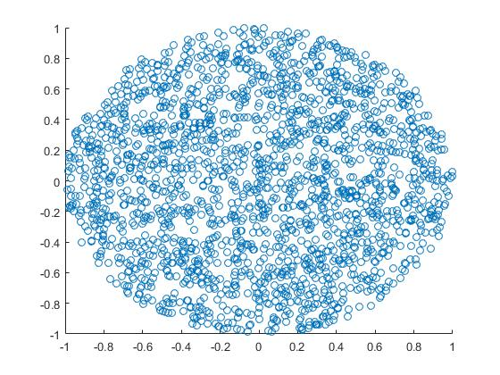
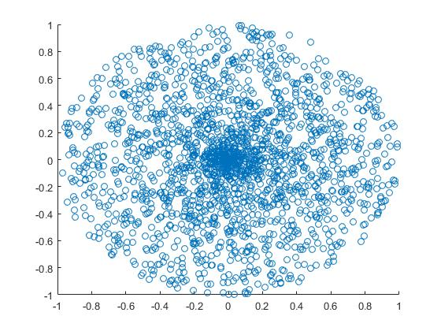
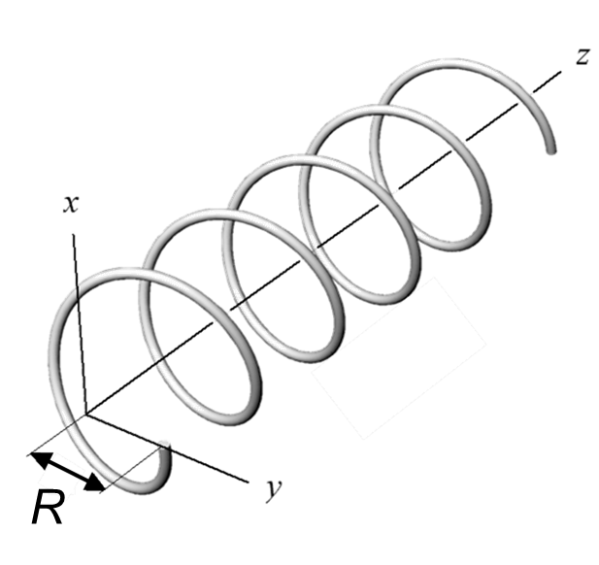
Fiber Distribution Fitting
Fiber migration:
R_{i}
(ready)
Fiber-level params
For all fibers
Per-fiber
r_{min}, r_{max}, s, R_{i}, θ_{i}
Cross-Sectional Fiber distribution:
1D probability density on R_{i}
Two distributional parameters
Distribution fitting
Input: for each fiber i
Output: two distributional parameter values
Fiber curve
Solution: maximum likelihood estimation (MLE)
Distribution 1
Distribution 2
Notes:
With the migration parameters recovered, we then compute the fiber distribution.
[Click] As in prior work, this distribution is modeled as a 1D probability density on “big R”, the distance from fiber centers to the ply center.
[Click] Taking the recovered original distances, [click] the problem boils down to standard distribution fitting, which we solve using maximum likelihood estimation.

Slide 45
Fiber-Level Fitting: Flyaway Fibers
Measured yarn geometry
Ply-level fitting
=
+
All fibers in untied plies
Regular fibers
Flyaway fibers
Notes:
With the regular fibers handled, the remaining task is to process the flyaway fibers.

Slide 46
Our Flyaway Model
Reference (measured)
No flyaway
(procedurally generated)
Perlin-noise based flyaways
(procedurally generated)
Our flyaway model
(procedurally generated)
Difficult to fit with
Limited representative power
Easy to fit with
Better representative power
Notes:
Flyaway fibers are crucial to visual realism.
Without them, the fit looks too perfect to be real.
[Click] The Perlin-noise based approach used in prior work has limited representative power and, more importantly, difficult to fit to.
[Click] Our flyaway model, on the other hand, is easy to fit with and matches the reference well.
Please see our paper for more details.

Slide 47
Fiber-Level Fitting
Measured yarn geometry
Ply-level fitting
=
+
All fibers in untied plies
Regular fibers
Flyaway fibers
Notes:
Now we have all fiber-level parameters obtained, …

Slide 48
Summary
Fibers
Fiber-level fitting
Plies
Ply-level fitting
Yarns (input)
Measured yarn geometry
Output
Output
Physical samples
Untied plies
Notes:
…, completing the entire fitting pipeline.

Slide 49
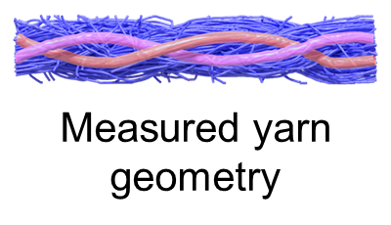
Summary
Data-driven
Procedural
Measured yarn geometry
Our method
Notes:
This is how our method converts data-driven models into procedural ones.

Slide 50
Results
Notes:
We now show some results.

Slide 51
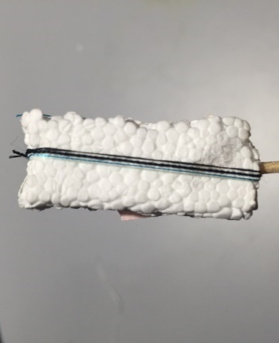
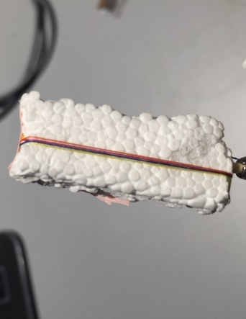
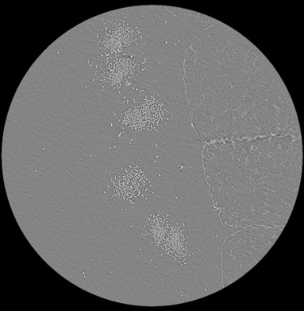
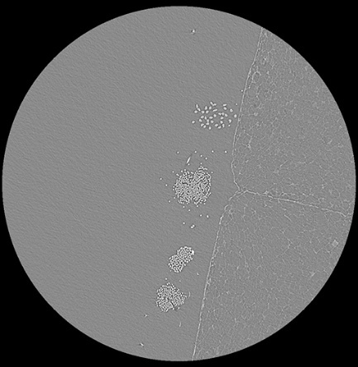
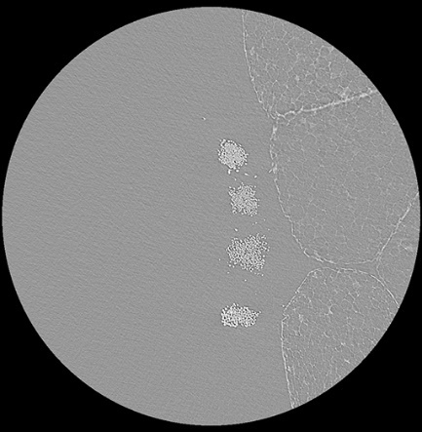
Experiments
Used 9 commonly available yarns
2 Cotton, 4 Rayon, 2 Silk, 1 Polyester
Micro-geometry acquired using micro CT (resolution: 2-5 μm)
Fitting performance (per-yarn):
< 10 CPU core minutes
Negligible compared to acquisition and processing of CT data
Notes:
We measured 9 commonly used yarns using micro CT imaging and fit procedural representations to them.
[Click]
Our fitting algorithm is fast: it only takes a few CPU core minutes to process a yarn.
This is negligible compared to acquisition and processing of CT data, each of which takes several hours.

Slide 52
Validations
Measured
Fitted
Photo
Rendered
Notes:
To validate our approach, we compared our fitted geometries with the measured ones.
The left column contains renderings using data-driven models with measured geometries.
The second column shows rendered images with our fitted procedural models.
Our approach successfully captures the statistical characteristics of the input.
[Click]
The right two columns show a comparison between photographs and images rendered with our models.
Since the main focus of this paper is geometry, we set the optical parameters manually.
In the future, one can use more sophisticated techniques, such as the one from the previous talk, to achieve better appearance matches.

Slide 53
Procedurally Generated Long Yarns
No repeated patterns!
Notes:
Our procedural models can generate arbitrarily long yarns without repeated patterns.

Slide 54
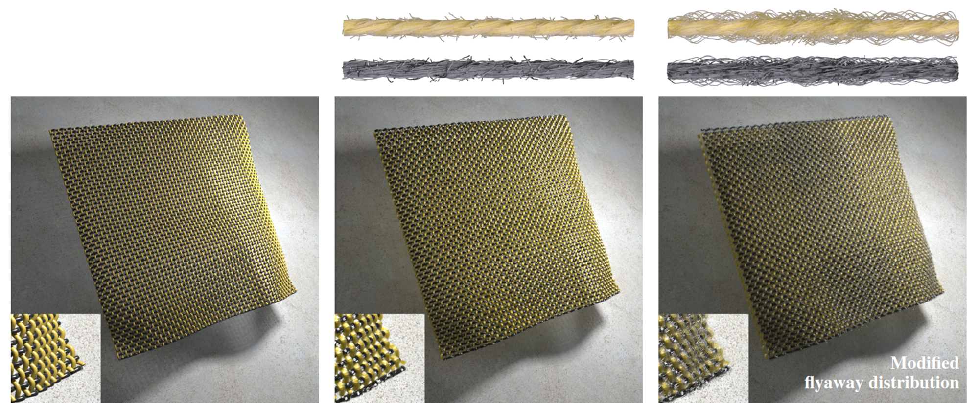
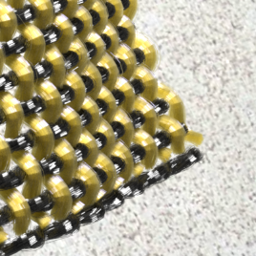
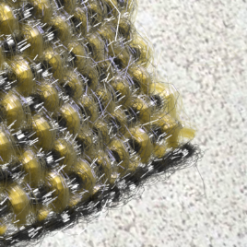
Edited Result 1: Modified Flyaway Distribution
Individual yarns
(a) Yarn curves only
(b) Original parameters
(c) Edited parameters
Notes:
Our fitted parameters enable intuitive editing.
Here we show a rendered fabric made of rayon yarns.
The left image shows a visualization of the yarn curves.
Without fiber-level details, it does not look very realistic.
[Click] With such details added with our fitted model, much higher realism can be achieved.
[Click] Here we show an edit example with increased ply hairiness.
[Click] This causes the whole cloth appear darker due to stronger self-occlusion, [click] as demonstrated in the zoomed renderings.

Slide 55
Edited Result 2: Modified Cross-Section
Individual yarn
Individual yarn
(a) Yarn curves only
(b) Original parameters
(c) Edited parameters
Notes:
Now we show a rendered cloth composed of polyester yarns.
[Click] We modified the model parameters to make the ply cross sections highly elliptical.
[Click] This causes the strength & distribution of surface highlights to change considerably, demonstrating once again how fiber-level manipulations affect overall appearance.

Slide 56
Continuous Parameter Changes
Notes:
Finally, we show how yarns change with continuously varying parameters.
Here we show changing:
Ply & fiber twisting
Length of flyaway fibers
Ply cross section & fiber migration

Slide 57
Conclusion
Our work
Statistical parameters
Data-driven models
Procedural models
Compact representation
Parameter fitting
Intuitive editing
Notes:
To conclude, we developed a new parameter fitting method to compute procedural models based on physical measurements.
[Click] Our results enable compact representation and intuitive editing.

Slide 58
Limitations & Future Work
Modeling yarn-yarn interactions, full textiles
Animating procedural models
Building model databases
Notes:
Currently, the procedural yarn model does not consider yarn-yarn interactions which occur everywhere in real fabrics.
In the future, we want to extend the model to capture such effect to better model full textiles.
[Click] Also, we are interested in animating our procedural fabrics via physically based simulation.
[Click] Lastly, we intend to build a database of procedural yarns that allows users to directly use our fitted parameters without having to make physical measurements themselves.

Slide 59
Acknowledgements
Kai Schröder
Procedural yarn model
Pramook Khungurn
Fiber curve extraction
Funding
NSF IIS 1513967
Notes:
We would like to thank Kai Schroder for adopting the procedural model and sharing his implementation.
We thank Pramook from the previous talk for helping us extracting fiber curves from CT scans.
We also thank our funding agency, …

Slide 60
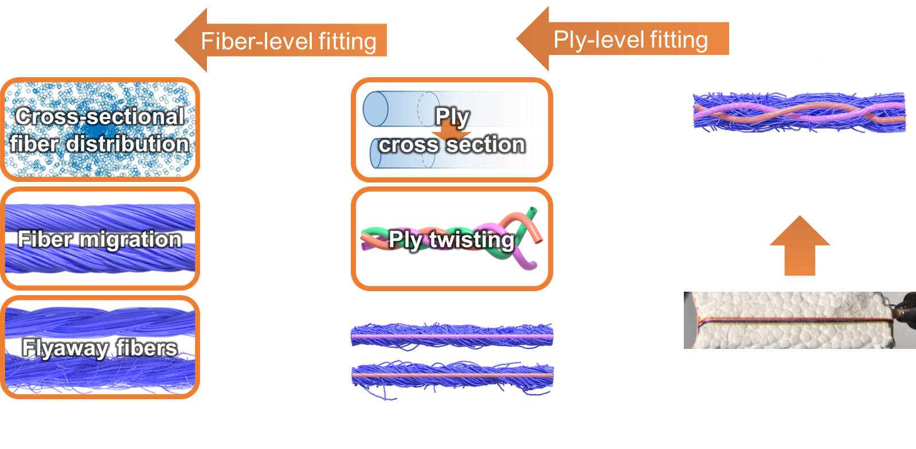
rayon
cotton
Silk
Thank you!
Notes:
…, and thank you for your attention.

Slide 61
Fiber Migration Fitting
Our solution: optimizing r_{min}, r_{max}, s, R_{i}, θ_{i} jointly:
Fiber-level params
Per-fiber reconstruction error
Enumerate
Choose (r_{min}, r_{max}, s) with minimal total error
Idea: per-fiber error easy to compute given r_{min}, r_{max}, s
Notes:
Fortubately, when r_min, r_max, and s are given, minimizing E_i becomes a curve fitting problem and can be solved easily.
[Click] Therefore, we enumerate a discretely sampled sets of these parameters and choose one with minimal total error.

Slide 62
Step 4: Our Flyaway Fiber Model
Two types of flyaway fibers
Hair-type
Loop-type
Inspired by results from textile research [Voborova et al. 2004]
Notes:
Before describing how we fit the parameters, let me first describe our flyaway fiber model.
Inspired by results from textile research, we consider two types of flyaway fibers: hair and loop.

Slide 63
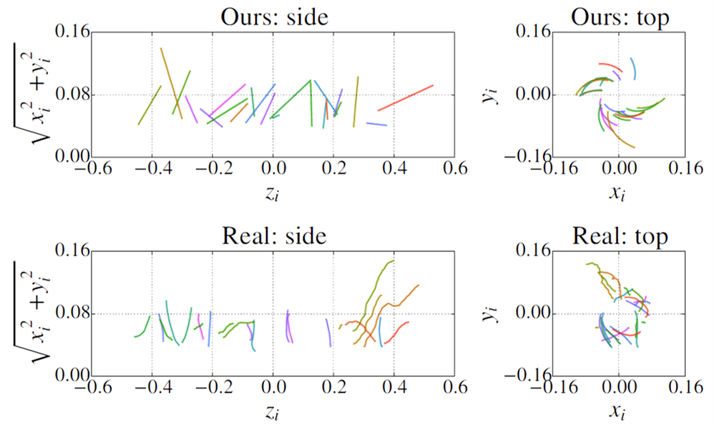
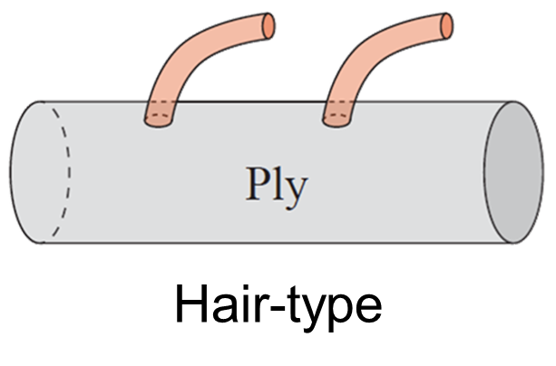
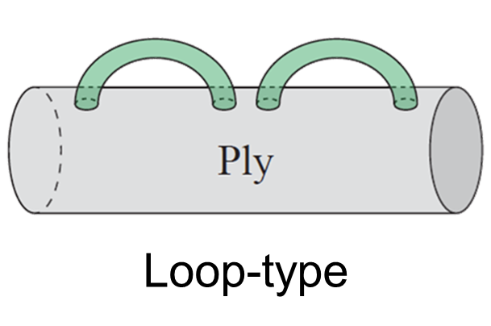
Step 4: Hair-Type Flyaways
Modeled as “arcs” (specified with two endpoints)
Distributions:
Starting location: uniformly distributed
Size: normally distributed
Flyaway fibers
Hair-type
Notes:
Each hair-type flyaway fiber has one endpoint sticking out of the main ply.
We model these fibers with arcs that can be fully specified with two endpoints.
[Click]
In terms of spatial location, we assume the hair-type flyaways to be uniformly distributed with normally distributed sizes.

Slide 64
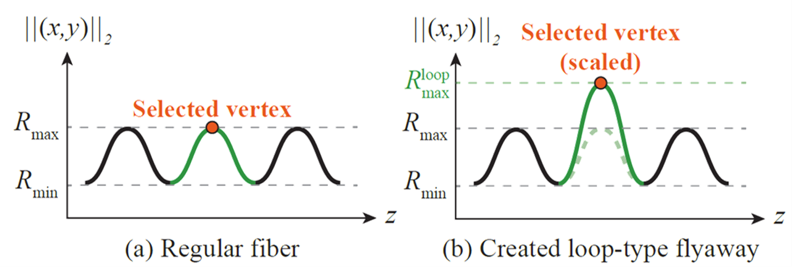
Step 4: Loop-Type Flyaways
Modeled as “mutated” regular fibers
Distributions:
Selected vertex: uniformly distributed
Scaled R: normally distributed
Flyaway fibers
Notes:
Loop-type flyaway fibers leave no endpoints beyond the main ply.
We model these fibers by mutating the regular ones.
The mutation is done by [click] picking a vertex with maximal distance and [click] scaling the distance up to make a visible loop.
[Click]
We assume the mutated vertices to be selected uniformly at random, and the ratio of scaling to be normally distributed.

Slide 65
Step 4: Flyaway Model Fitting
Estimating model parameters boils down to
Examining each flyaway fiber
Computing statistics (e.g., mean & standard deviation)
See the paper for more details!
Flyaway fibers
Notes:
Given our model definition, the fitting process is easy: we only need to examine all flyaway fibers and compute the required statistics.
Please see the paper for more details.

