Slide 1
High-Order Similarity Relations in Radiative Transfer
Shuang Zhao¹, Ravi Ramamoorthi², and Kavita Bala¹
¹Cornell University ²University of California, San Diego
Notes:
Thank you.
Today I will talk about similarity theory and its applications in graphics.

Slide 2
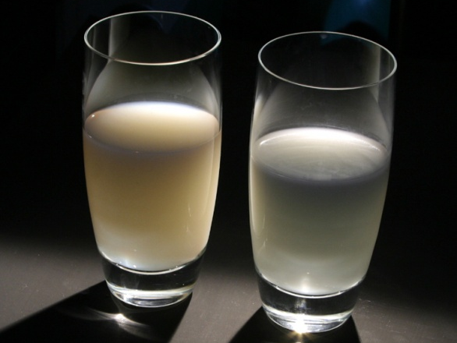
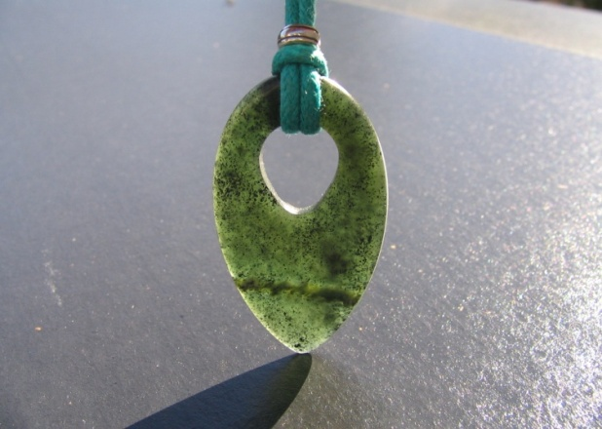
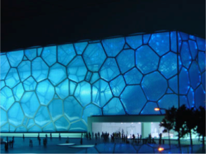
Translucency is everywhere
Food
Skin
Architecture
Jewelry
Slide courtesy of Ioannis Gkioulekas
Notes:
In the real world, translucency is everywhere.
For example, a wide range of things that we [click] eat and [click] wear are translucent.
[Click] Our body also scatters light.
[Click] Many beautiful architectures involve translucency as well.

Slide 3
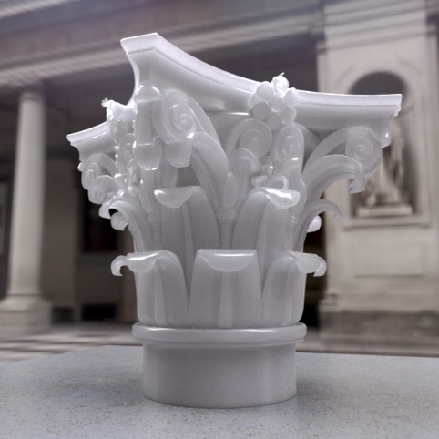
Rendering translucency
Appearance
Radiative transfer
Scattering param.
Notes:
To reproduce the appearance of a translucent object, a set of scattering parameters are used.
These parameters can then [click] be fed into the radiative transfer framework, [click] to obtain the object appearance.
(Preview: Interestingly, different sets of parameters, …)

Slide 4
Rendering translucency
Appearance 1
Radiative transfer
Scattering param. 1
Appearance 1
≈
≠
Radiative transfer
Radiative transfer
Scattering param. 2
Scattering param. 1
Radiative transfer
Appearance 2
Scattering param. 2
Appearance 2
Notes:
Interestingly, different sets of parameters, under the same environment, can produce approximately identical appearance.
(Preview: Many prior work in graphics …)

Slide 5
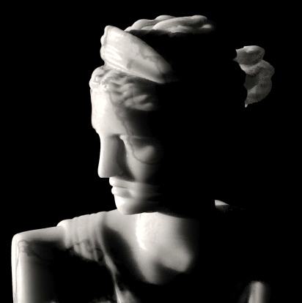
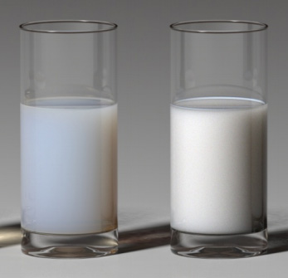
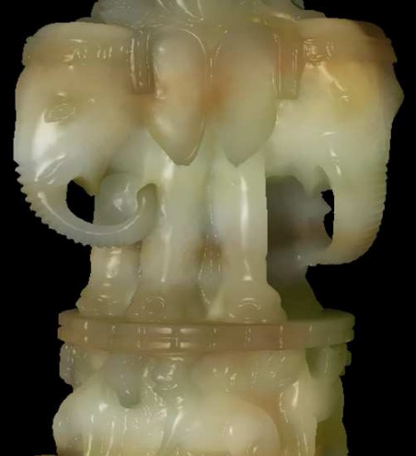
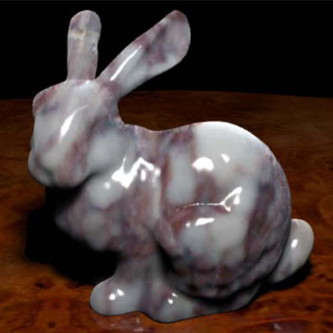
First-order methods
Approx. identical appearance
First-order approx.
Limited accuracy
Scattering param. 1
Scattering param. 1
Scattering param. 2
Cheaper to render
Scattering param. 2
[Jensen et al. 2001]
[Frisvad et al. 2007]
[Wang et al. 2009]
[Arbree et al. 2011]
Notes:
Many prior work in graphics has exploited this effect to speedup the rendering of participating media.
They alter the material scattering parameters so that [click] the resulting new material has a similar appearance but can be much cheaper to render.
These methods, however, are based on [click] a first-order approximation of radiative transfer, [click] and has limited accuracy.
(Preview: Similarity theory is a significant theoretical generalization …)

Slide 6
Similarity theory
First-order methods
First-order approx.
First-order approx.
Scattering param. 1
Scattering param. 1
Scattering param. 2
Scattering param. 2
Similarity relations
Similarity theory
[Wyman et al. 1989]
Scattering param. 1
Scattering param. 2
Notes:
Similarity theory is a significant theoretical generalization of the first-order approach.
[Click] It relates different scattering parameters using a series of equivalence relations, called “similarity relations”.

Slide 7
Similarity theory
Provide fundamental insights into the structure of material parameter space
Similarity relations
Similarity theory
[Wyman et al. 1989]
Scattering param. 1
Scattering param. 2
Notes:
This theory provides fundamental insights into the structure of material parameter space.

Slide 8
Similarity theory
Originates in applied optics [Wyman et al. 1989]
Similar ideas explored in neutron transfer
(Condensed History Monte Carlo) [Prinja & Franke 2005], [Bhan & Spanier 2007], …
Similarity relations
Similarity theory
[Wyman et al. 1989]
Scattering param. 1
Scattering param. 2
Notes:
Similarity theory is originally proposed by Wyman et al. in applied optics.
Similar ideas have been explored by the neutron transfer community.

Slide 9
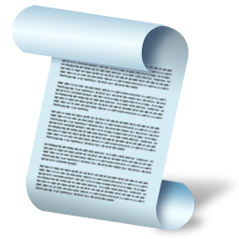
Our contribution
Introducing high-order
similarity theory to computer graphics
Novel algorithms benefiting forward & inverse rendering
Notes:
Our paper provides a complete exposition of similarity theory, in its general high-order form.
[Click] We also introduce novel algorithms which utilize this theory and can benefit forward and inverse rendering of translucent media.

Slide 10
Our contribution: forward rendering
User-specified
(balancing performance and accuracy)
Approx. identical appearance
Our approach
Better accuracy
Scattering param. 1
Scattering param. 2
100 ~ 200 lines of MATLAB code
Cheaper to render
Up to 10X speedup
Notes:
Forward rendering is our main application.
Given a set of scattering parameters, [click] our approach takes a user-specified parameter [click] and outputs another set that leads to approximately identical appearance.
Our method is simple yet powerful.
[Click] It can be implemented with just a few hundred lines of MATLAB code.
[Click] But the parameters it produces can result in speedups up to 10X.
Comparing to first-order methods, [click] our approach can offer much better accuracy.

Slide 11
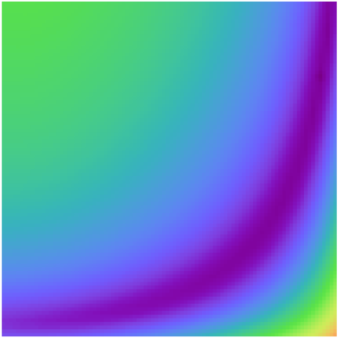
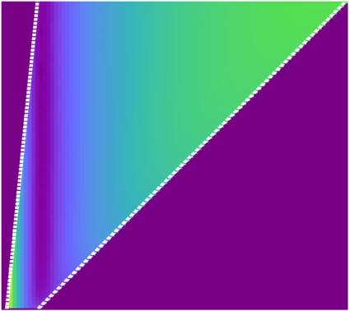
Our contribution: inverse rendering
Gradient descent methods perform much better
Reparameterize
Parameter space 2
Parameter space 1
Notes:
The insights brought by similarity theory can also benefit inverse rendering applications.
[Click] In particular, we show that one can reparameterize the search space [click] to greatly improve the performance of gradient descent methods.
Unfortunately, I do not have time to go through the details.
If you are interested in this application, please see our paper.

Slide 12
Background
Notes:
Next, let me give some background on material scattering parameters.

Slide 13
Material scattering parameters
Light particle
Extinction coefficient
Absorption coefficient
Interaction
Scattering coefficient
Scattered
Absorbed
Phase function
Notes:
While a light particle travels, [click] it always go straight for a random distance before interacting with the surrounding medium.
[Click] The extinction coefficient controls the average of such distance, or “mean free path”.
When the particle interacts with the medium, it has a chance [click] to be absorbed.
[Click] The scattering coefficient controls how likely this happens.
[Click] The difference between the extinction and the scattering coefficient is called the absorption coefficient.
[Click] If the particle is not absorbed, it will be scattered into a random direction.
[Click] The phase function controls the distribution of this new direction.

Slide 14
Phase function
Scattered
Probability density for , parameterized as
Forward
Forward
Isotropic scattering
Forward scattering
Notes:
In practice, the phase function f is often parameterized as a function of the angle \theta, or the cosine of this angle, between the original and the new directions.
[Click] When f is constant, the light particle is scattered uniformly over all directions.
This is called isotropic scattering.
[Click] On the other hand, if f concentrates energy around the original, which is also known as the “forward”, direction, the material is considered “forward scattering”.
[Click] Here we show 3D polar plots of the two phase functions where the original directions point to the right.

Slide 15
Similarity Theory
Notes:
We have briefly reviewed the scattering parameters.
Next, I will describe how similarity theory works.

Slide 16
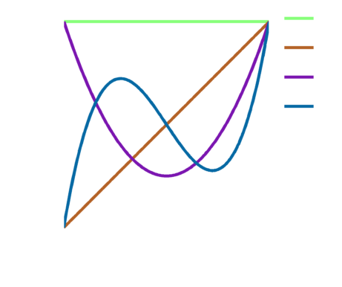
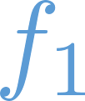
Phase function moments
n^{th} Legendre moment
Legendre polynomial
For a phase function
“Average cosine”
Notes:
Similarity theory reasons about phase functions based on their Legendre moments.
These moments are defined as integrals of the phase function times [click] the Legendre polynomials, a function basis defined between -1 and 1.
[Click]
The 0-th Legendre moment of any phase function equals 1 since they are probability densities.
[Click] The 1-st moment of a phase function is sometimes called its “average cosine”.

Slide 17
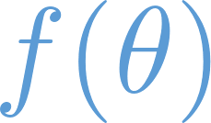
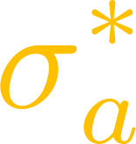
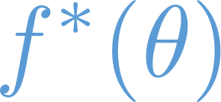
Similarity relations
Low-frequency radiance
Band-limited up to order-N in spherical harmonics domain
…
[Wyman et al. 1989]
Notes:
Assume there is an object under certain environment such that the radiance field inside has low angular frequency.
[Click] Precisely, the radiance at any point is band-limited up to order-N in the spherical harmonics domain.
[Click]
Then, consider another object with an altered set of parameters denoted with star-superscripts.
If the conditions shown on the bottom are satisfied,
(Preview: When putting this …)

Slide 18
Similarity relations
Radiance
low-frequency everywhere
identical appearance
Order-N similarity relation
Derivation in the paper
[Wyman et al. 1989]
…
…
Notes:
When putting this new object under the same environment, it will appear exactly the same as the original.
[Click] The set of conditions that guarantees this to happen is called similarity relation of order-N.
[Click] In our paper, we provide a complete derivation of these relations.

Slide 19
Similarity relations
Approximately
Radiance
low-frequency everywhere
identical appearance
Higher order, Better accuracy
Order-N similarity relation
…
Notes:
In practice, the radiance in the original object may NOT be low-frequency everywhere.
[Click] In this case, the two objects will appear approximately the same.
[Click] Normally, altered parameters satisfying higher-order similarity relations offer better accuracy.

Slide 20
Challenge
Order-N similarity relation
?
?
…
Order-N similarity relation
Original (given)
Altered (unknown)
…
Notes:
Given a set of original parameters, finding altered ones satisfying high-order similarity relations is nontrivial.
Next, we introduce a novel approach to solve this problem.

Slide 21
Solving for Altered Parameters
Notes:
(Wait for the next slide …)

Slide 22
The problem
Original parameters
Forward
Altered parameters
?
?
?
Order-N similarity relation
Constraints
…
Notes:
I will explain how our approach works using an example.
Suppose we are given a set of parameters, as shown on the top, [click] and would like to find an altered set such that [click] similarity relation of order-N is satisfied.
Unfortunately, [click] only the altered absorption coefficient is directly given.
[Click] The remaining equations are constraints.
(Preview: Now consider \alpha defined as …)

Slide 23
The problem
Original parameters
Forward
Altered parameters
?
?
Order-N similarity relation
Order-N similarity relation
…
…
…
Notes:
Now consider \alpha defined as the ratio between the altered and the original scattering coefficients.
[Click]
It is easy to see that \sigma_s^* and the Legendre moments of f^* are uniquely determined by \alpha.
(Preview: Let us assume \alpha is given for now …)

Slide 24
The problem
Original parameters
Forward
Altered parameters
?
?
Order-N similarity relation
…
…
Notes:
Let us assume \alpha is given for now.
[Click] Then the value of the altered scattering coefficient can be obtained.
(Preview: At this point, only the altered phase function remains unknown …)

Slide 25
Altered phase function
Original parameters
Forward
Altered parameters
?
Remaining unknown
Altered parameters
?
…
…
Notes:
At this point, only the altered phase function remains unknown.
(Preview: Instead, we know …)

Slide 26
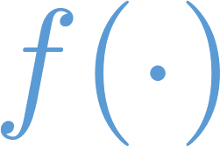
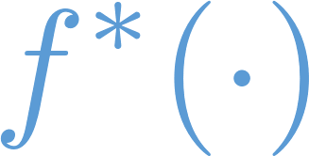
Altered phase function
Original parameters
Forward
Legendre moments of
Remaining unknown
Altered parameters
?
Legendre moments of
…
Notes:
Instead, we know the Legendre moments this function needs to have, [click] which can be computed using \alpha and the moment values of the original phase function.

Slide 27
Altered phase function
Altered parameters
?
Order-1
Normalization constraint
Order-2
Altered parameters
?
Order-3
Order-4
…
Finding highest satisfiable order N
Notes:
Now we can compute the desired Legendre moment of any order.
Remember that the 0-th moment needs to be 1 since f^* is a probability density.
[Click] To satisfy the order-1 similarity relation, f^* needs to match the given moment values up to order-1.
[Click] To satisfy the order-2 relation, f^* needs to match up moments to order-2.
[Click] And so on.
However, at some point, there will be no function matching all these moments.
[Click] So we would like to find the greatest N such that similarity relation of that order is satisfiable.

Slide 28
Finding order N
Existence condition
(Truncated Hausdorff moment problem)
[Curto and Fialkow 1991]
Given desired Legendre moments
Hankel matrices built
using are positive semi-definite
Phase function
Does phase function exist?
exists
Notes:
To achieve this, the key is to find the conditions for f^* to exist.
[Click]
Fortunately, this problem has been studied in probability theory, and it has been shown that f^* exists if and only if certain Hankel matrices built using the given Legendre moments are positive semi-definite.

Slide 29
Finding order N
Altered parameters
?
Order-1
Order-2
Order-3
Order-4
…
Finding highest satisfiable order N
Notes:
By knowing the existence condition of f^*, we can easily find N.
In this example, [click] similarity relations up to order-3 are satisfiable, [click] but not for the order-4 version.
[Click] So we pick N = 3.
(Preview: Next, we need to …)

Slide 30
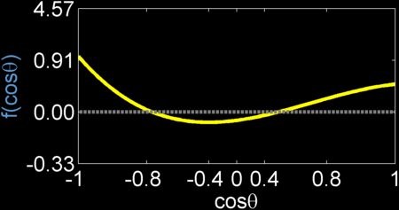
Altered phase function
Altered parameters
?
Order-3
Problem: not uniquely specified
Order-3
Invalid
Valid
Valid
Notes:
Next, we need to build a function f^* such that its 0-th through 3-rd Legendre moments match the given values.
[Click]
Unfortunately, there are infinitely many functions with these moment values.
Three examples are shown on the bottom.
Another challenge is that f^*, as a phase function, needs to be non-negative.
[Click] So the first example is not valid.
Next, I will describe how to find a solution that is both valid and able to produce high-quality renderings.

Slide 31
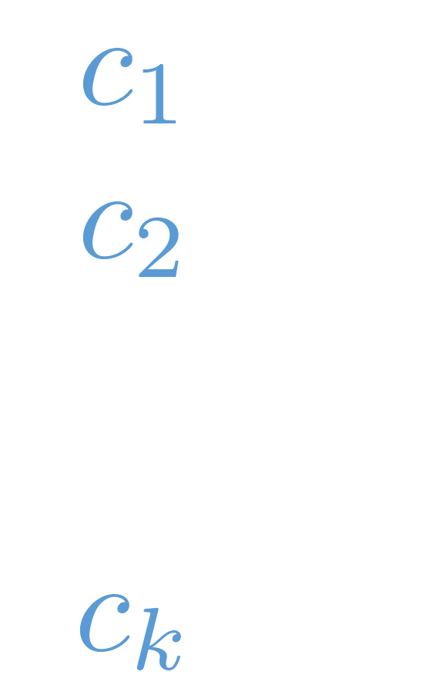
Constructing altered phase function
Represent as a tabulated function with pieces
?
…
…
0
0
-1
-1
1
1
has Legendre moments
Need:
non-negative
Notes:
We represent f^* as a tabulated (or piece-wise constant) function with k equal-sized pieces.
[Click] The remaining problem is to solve for the vector containing the function value in each piece.
[Click] We denote this vector as “bold c”.
[Click] Recall that we need f^* to have a given set of Legendre moments and to be non-negative.
[Click] Since f^* is now tabulated, the second constraint becomes that c must be non-negative component-wise.
[Click] Due to linearity of integral, the first constraint can be written as a linear system,
(Preview: where bold f^* is a vector containing …)

Slide 32
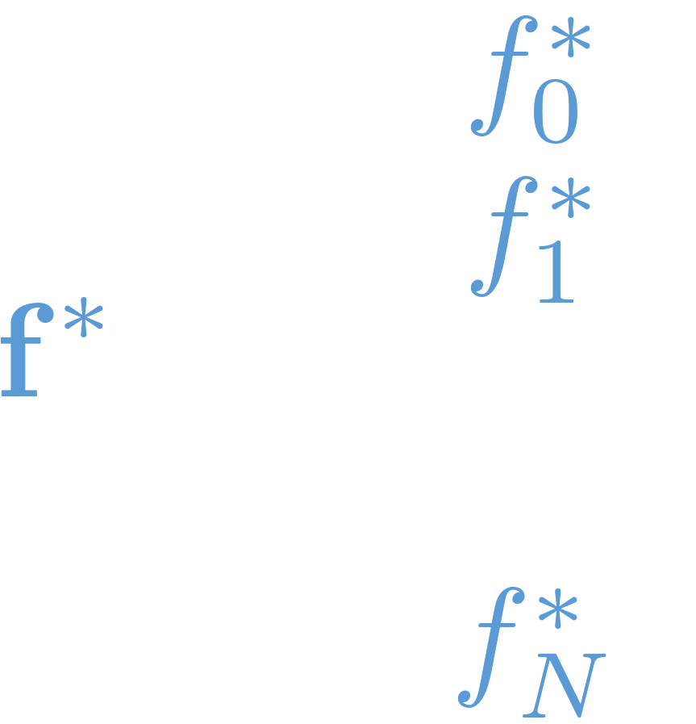
Constructing altered phase function
Represent as a tabulated function with pieces
?
Const.
Need:
Notes:
… where bold f^* is a vector containing the desired Legendre moments, and G is constant.

Slide 33
Constructing altered phase function
Solve
subject to
Smoothness term
(favoring “uniform” solutions)
Good
Bad
0
0
-1
1
-1
1
Notes:
Then, we solve an optimization problem subject to these constraints.
[Click]
Precisely, we minimize a smoothness term that favors solutions that redirect light uniformly into a range of directions.
Such “uniform” solutions generalize better to different environments.

Slide 34
Constructing altered phase function
Solve
subject to
Quadratic programming
Standard problem
Solvable with many tools/libraries
MATLAB, Gurobi, CVXOPT, …
Our MATLAB code is available online
Notes:
This optimization can be solved using quadratic programming.
[Click] Fortunately, this is a standard problem and can be solved efficiently using many existing tools and libraries.
[Click] We have made our MATLAB implementation publicly available.

Slide 35
Constructing altered phase function
Altered parameters
?
Order-3
Our approach
Invalid
Valid
Valid
Notes:
Back to the example.
[Click] With the method I just described, an altered phase function f^* can be constructed, [click] completing our search for altered parameters.
(Preview: This phase function has an interesting …)

Slide 36
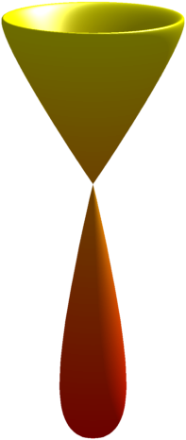
Constructing altered phase function
Altered parameters
Forward
Notes:
This phase function has an interesting “wine-glass shape”.
It sends a considerable amount of light forward but to off-axis directions.
(Preview: In summary, to find the altered parameters, …)

Slide 37
Summary
Forward
Altered parameters
Forward
Original parameters
Compute order N
Solve optimization
Altered parameters
Forward
Notes:
In summary, to find the altered parameters, our method [click] keeps the absorption coefficient unchanged and [click] scales the scattering coefficient based on the user-specified parameter \alpha.
[Click]
To obtain the altered phase function, our method first finds the highest order of similarity relation that is satisfiable, and then solves an optimization problem to construct f^* numerically.

Slide 38
Application: Forward Rendering
Notes:
Next, I will explain how our approach benefits forward rendering of translucent media.
Inverse rendering applications are discussed in the paper.

Slide 39
Our contribution: forward rendering
User-specified
(balancing performance and accuracy)
Approx. identical appearance
Our approach
Better accuracy
Scattering param. 1
Scattering param. 2
Cheaper to render
Effort-free speedups!
Notes:
Our approach can be used to find altered parameters that produce approximately identical appearance while take less time to render.
[Click] Note that such speedup is effort-free, as we do not have to modify the core rendering algorithm at all!
[Click]
In our approach, the user-specified parameter \alpha plays an important role by controlling the tradeoff between resulting performance and accuracy.

Slide 40
Application: forward rendering
0
1
small
large
Worse accuracy
Greater speedup
Better accuracy
Lower speedup
No change in parameters
Perform test renderings to find optimal
Reuse for high-resolution renderings or videos
is a good start
Notes:
In particular, this parameter ranges from 0 to 1.
[Click] \alpha being one corresponds to setting the altered parameters identical to the original.
[Click] When deviating from \alpha = 1, we start to gain speedup as the cost of losing accuracy.
[Click] When alpha is large, good accuracy can be obtained, but the speedup will be relatively limited.
[Click] When alpha is low, on the other hand, the resulting accuracy will be worse, but the speedup can be greater.
[Click]
To obtain the optimal \alpha, we perform test renderings of low-resolution images.
Note that after finding the best \alpha value, it can be reused to render high-resolution images or videos.
[Click] We recommend starting with \alpha = 0.3 for the test renderings.

Slide 41
Experimental Results
Notes:
Next, I will show some of the experimental results.

Slide 42
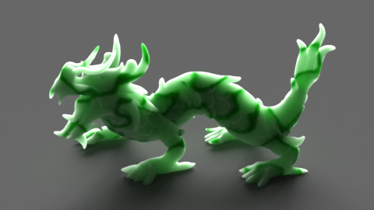
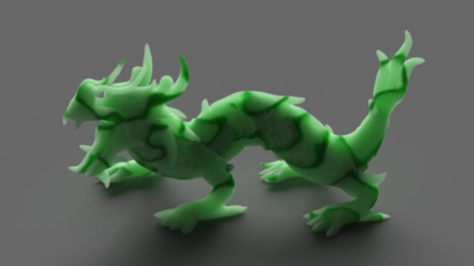
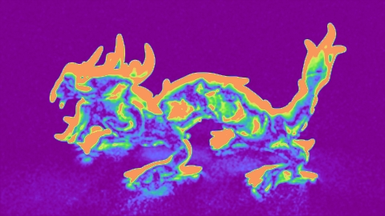
Performance vs. accuracy
Reference (350 min)
α = 0.05 (44 min, 8.0X)
30%
Relative error
0%
Notes:
Here we show the rendering of a translucent dragon generated using path tracing.
[Click] When rendered using altered parameters given by \alpha = 0.05, an 8X-speedup is achieved, but the accuracy is quite bad.
(Preview: If using \alpha = 0.1, …)

Slide 43
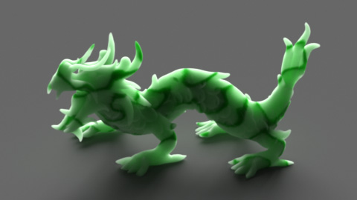
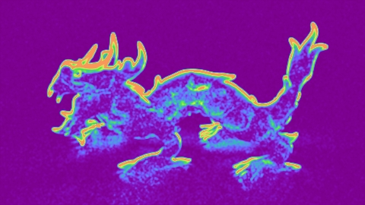
Performance vs. accuracy
Reference (350 min)
α = 0.05 (44 min, 8.0X)
α = 0.10 (63 min, 5.6X)
30%
30%
Relative error
0%
Relative error
0%
Notes:
If using \alpha = 0.1, we get better accuracy but the speedup goes down to 5.6X.

Slide 44
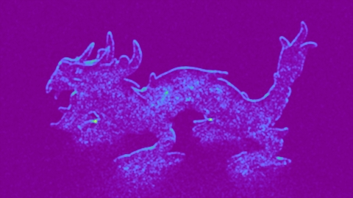
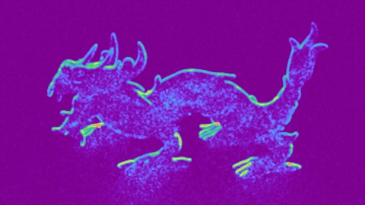
Performance vs. accuracy
Visually identical
α = 0.10 (63 min, 5.6X)
α = 0.20 (103 min, 3.4X)
α = 0.30 (126 min, 2.8X)
α = 0.10 (63 min, 5.6X)
30%
Relative error
Relative error
0%
Relative error
Relative error
Notes:
If one keeps increasing \alpha, more performance can be traded for accuracy.
[Click] In this example, when \alpha goes beyond 0.2, the resulting renderings are visually identical to the reference.
[Click] So \alpha = 0.2 is a good choice for this material.

Slide 45
Power of high-order relations
Original parameters
Forward
Altered parameters (Order-1)
Forward
Used by first-order methods:
Satisfies order-1 similarity relation
Reduced scattering coefficient
Notes:
Next we demonstrate the power of higher-order similarity relations.
Consider the example we saw earlier.
[Click] Using the traditional first-order approach, another set of altered parameters can be obtained.
[Click] This approach simply sets the altered phase function to isotropic, and reduces the scattering coefficient accordingly.
[Click] The resulting sigma_s^* is often called the “reduced scattering coefficient”.

Slide 46
Power of high-order relations
Original parameters
Forward
Altered parameters (Order-1)
Forward
Altered parameters (Order-3)
Forward
Notes:
Note that, comparing to the parameters found by our method, [click] the only difference is the two phase functions.

Slide 47
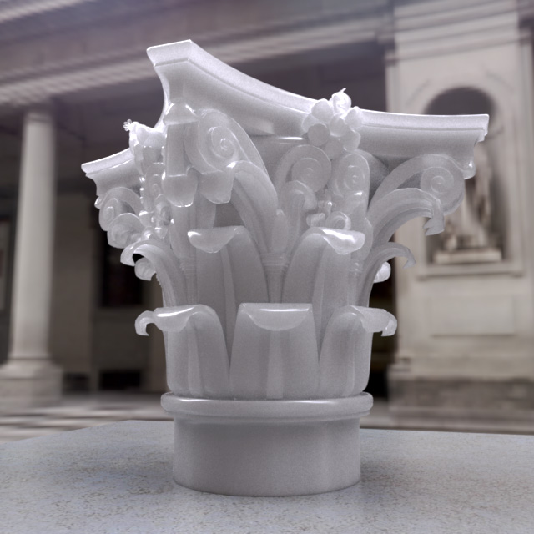
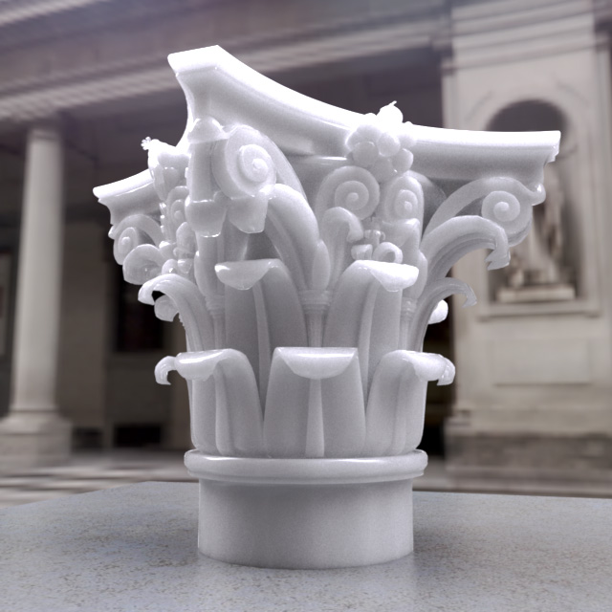
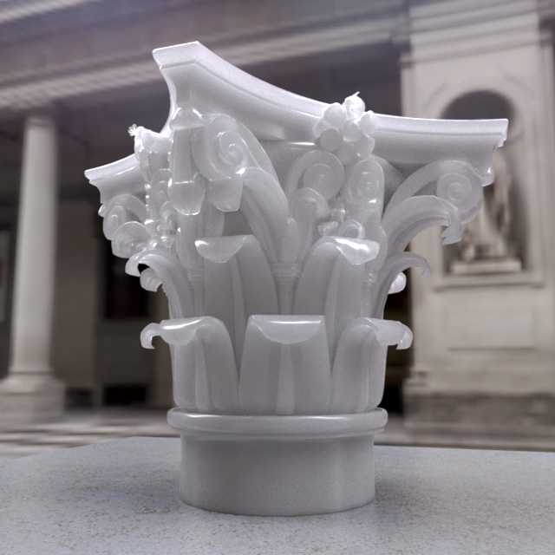
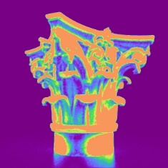
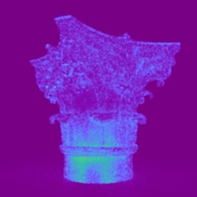
Power of high-order relations
Altered parameters (Order-1)
Altered parameters (Order-3)
Original parameters
Original parameters
Altered parameters (Order-1)
Altered parameters (Order-3)
426 min (reference)
119 min (3.6X)
115 min (3.7X)
Notes:
Now let us see how these altered parameters perform.
[Click] This is a path-traced rendering of a translucent capital with the original parameters.
[Click] When rendered with the same amount of samples, using the altered version satisfying the order-1 relation gives a 3.6X speedup, but the accuracy is not ideal.
[Click] On the other hand, the parameters found with our approach provide much better accuracy with even slightly better performance!

Slide 48
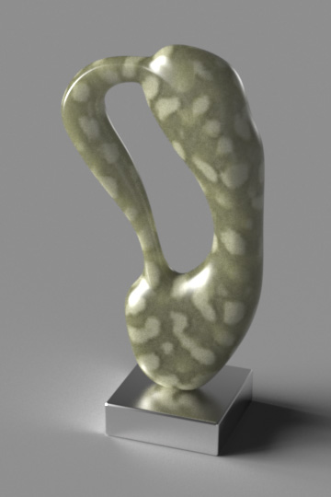
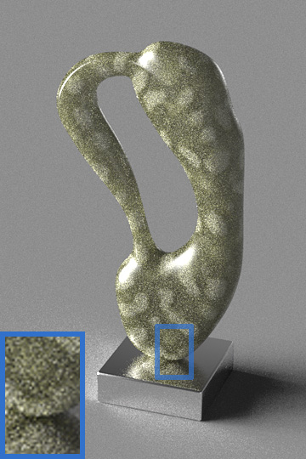
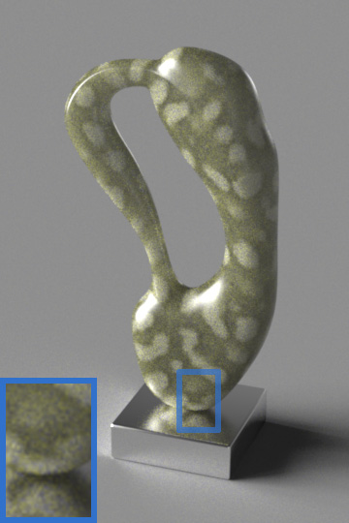
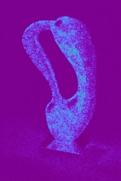
More renderings
Equal-sample
Equal-time
Reference 473 min
Ours 178 min (2.7X)
Reference 23 min
Ours 20 min
Notes:
Here we show a sculpture containing regions with greatly varying densities.
When rendered with equal number of samples, our method offers a 2.7X speedup with very good accuracy.
[Click]
When rendered in similar time, the rendering of our method has a much lower noise-level.
(Wait 5 seconds).

Slide 49
Conclusion
Order-N similarity relation
?
…
Original
Altered
Introducing high-order similarity relations to graphics
Proposing a practical algorithm to solve for altered parameters
Notes:
In conclusion, we have introduced higher-order similarity relations to graphics.
[Click]
In addition, we developed a novel algorithm to solve for the altered parameters satisfying these relations, which can offer “effort-free” speedups to forward rendering of translucent media.
In the paper, we show how similarity theory benefits inverse rendering applications.
We believe this theory is fundamentally important for rendering and can benefit many future applications.

Slide 50
Future work
Picking automatically and adaptively
Alternative versions of similarity theory
Notes:
In the future, we would like to be able to select the value of \alpha, which currently needs to be provided by the user, in automated and adaptive ways.
[Click] In addition, we would like to explore other possibilities to relate scattering parameters, based on methods proposed in applied physics and neutron transfer.

Slide 51
Thank you!
High-Order Similarity Relations in Radiative Transfer
Reference
Shuang Zhao¹, Ravi Ramamoorthi², Kavita Bala¹
¹Cornell University, ²University of California, San Diego
Project website: (MATLAB code available!)
www.cs.cornell.edu/projects/translucency
Ours (3.7X)
Funding:
NSF IIS grants 1011832, 1011919, 1161645
Intel Science and Technology Center – Visual Computing
Notes:
We would like to thank our funding agencies, and thank you for your attention.

Slide 52
Extra Slides
Notes:
Next, I will show some of the experimental results.
More results are available in the paper.

Slide 53
Order-1 similarity relation
Order-N similarity relation
Order-1 similarity relation
…
Special case (used by diffusion methods):
Reduced scattering coefficient
Notes:
Now we take a closer look at the similarity relations, starting from the simplest order-1 version.
It is easy to find altered parameters satisfying this relation.
Consider a special case where we set the altered phase function to isotropic.
In the case, its first Legendre moment equals 0.
Then, we can simply set the altered scattering coefficient to \sigma_s (1 – f_1) to satisfy the order-1 relation.
In fact, this altered scattering coefficient is often called the “reduced scattering coefficient” and is used extensively by diffusion methods.

Slide 54
Prior work: solving for altered parameters
[Wyman et al. 1989]
given by the user
fixed such that
Discrete scattering angle [Prinja & Franke 2005]
Represent as the sum of delta functions
“Spiky” phase functions do not perform as well as “uniform” ones for rendering applications
Notes:
In Wyman’s work where similarity theory was first introduced, a simple approach was proposed to solve for the altered parameters.
This approach takes an order N and constructs a phase function satisfying similarity relation of this order.
Unlike our method that allows choosing the value of \alpha continuously, this method fixes \alpha to one value such that f^*_N is 0.
So it does not offer as much flexibility as our method.
[Click]
Another method previously proposed to solve for the altered parameters is the discrete scattering angle method.
It represents f^* as the sum of a number of delta functions.
However, as mentioned earlier in the talk, such “spiky” phase functions do not generalize to difference environments as well as the more “uniform” ones, which are favored by our method.

Slide 55
Constructing altered phase function
Represent as a tabulated function with pieces
Solve
subject to
Quadratic programming
Hankel matrices built using being positive semi-definite
Existence condition

Slide 56
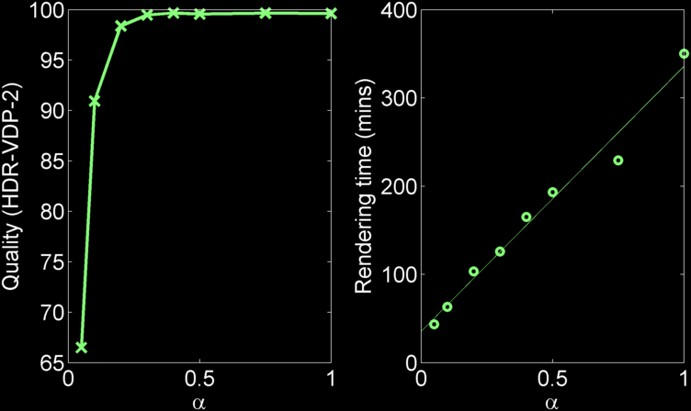
Performance vs. accuracy
Reference (350 min)
Notes:
Here we show how the resulting quality measured using a visual metric and the rendering time changes with \alpha.

Slide 57
Discarded Slides
Notes:
Next, I will show some of the experimental results.
More results are available in the paper.

